Slide 1
Titel XYZ
Name
Role

Slide 2
IPCC reports are the result of extensive work of many scientists from around the world.
1 Summary for Policymakers
1 Technical Summary
16 Chapters
235 Authors
800+ Reviewers
Close to 1500 pages
Close to 10,000 references
More than 38,000 comments

Slide 3
Climate change is a global commons problem that requires international cooperation and coordination across scales.
© ESA/NASA

Slide 4
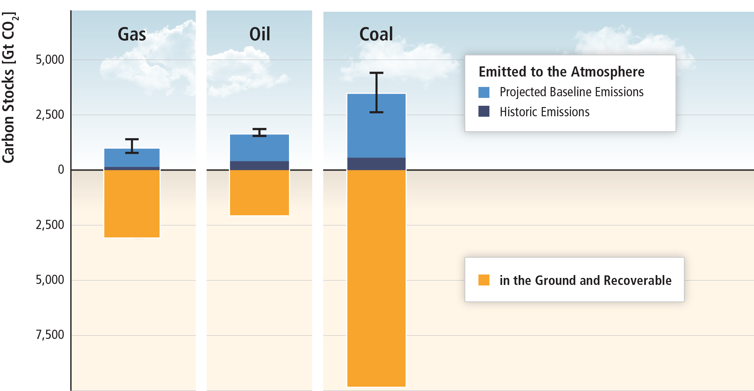
There is far more carbon in the ground than emitted in any baseline scenario.
Based on SRREN Figure 1.7

Slide 5
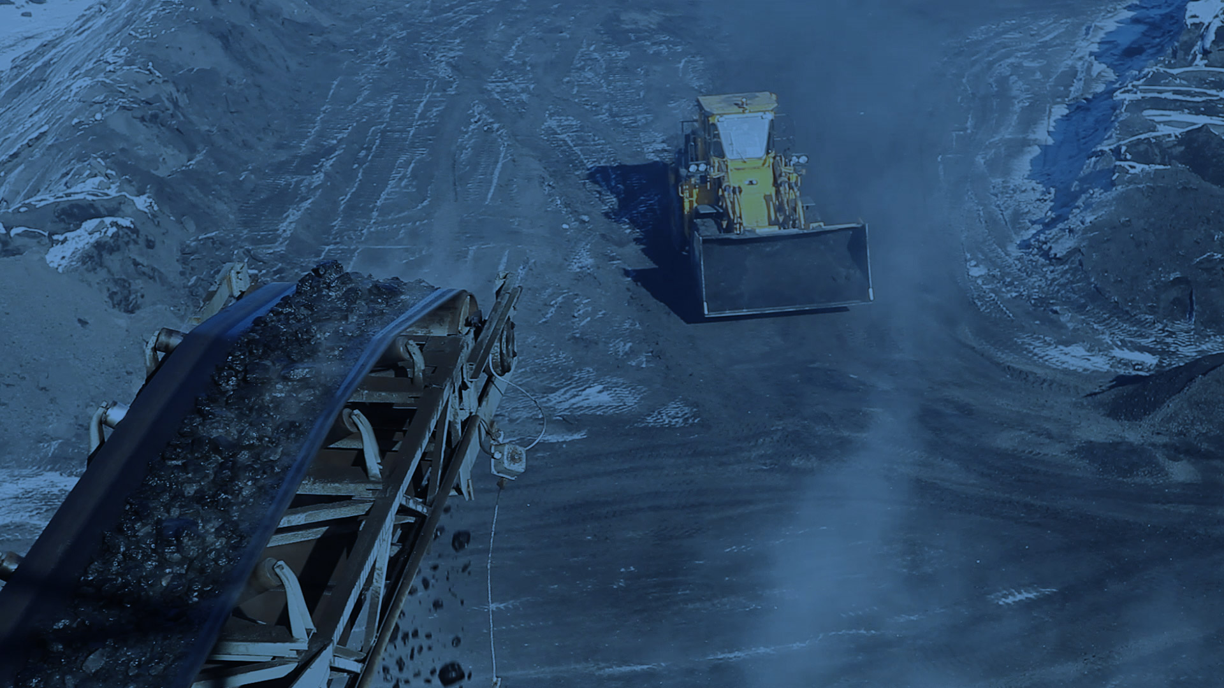
GHG emissions growth has accelerated despite reduction efforts.

Slide 6
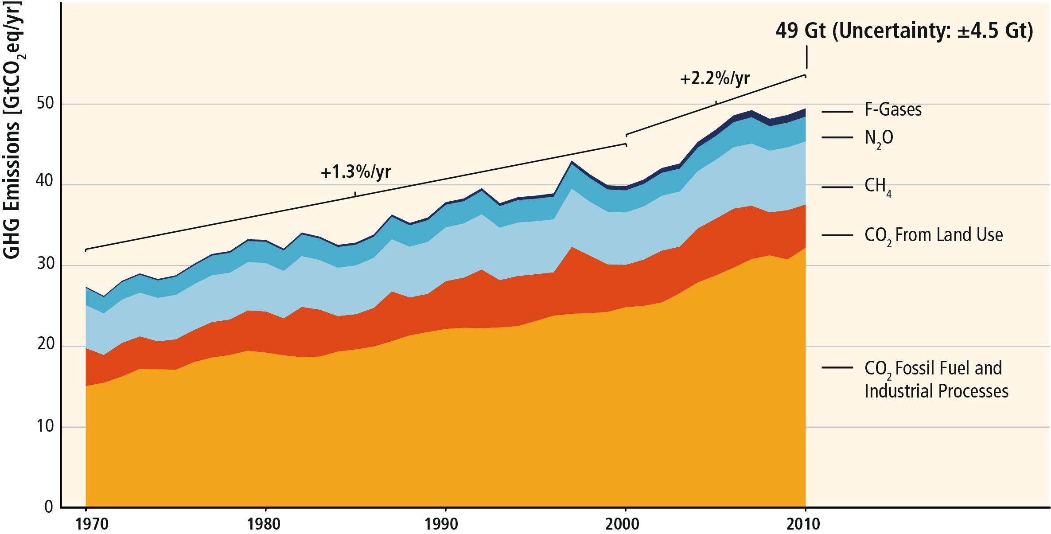
GHG emissions growth between 2000 and 2010 has been larger than in the previous three decades.
Based on Figure SPM.1

Slide 7
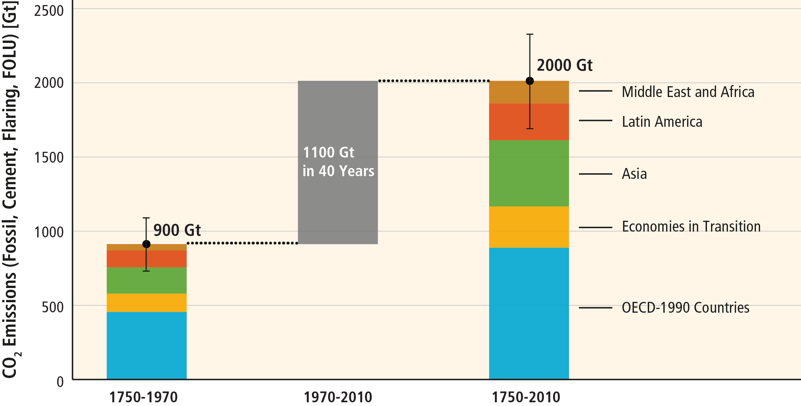
About half of the cumulative anthropogenic CO₂ emissions between 1750 and 2010 have occurred in the last 40 years.
Based on Figure 5.3

Slide 8
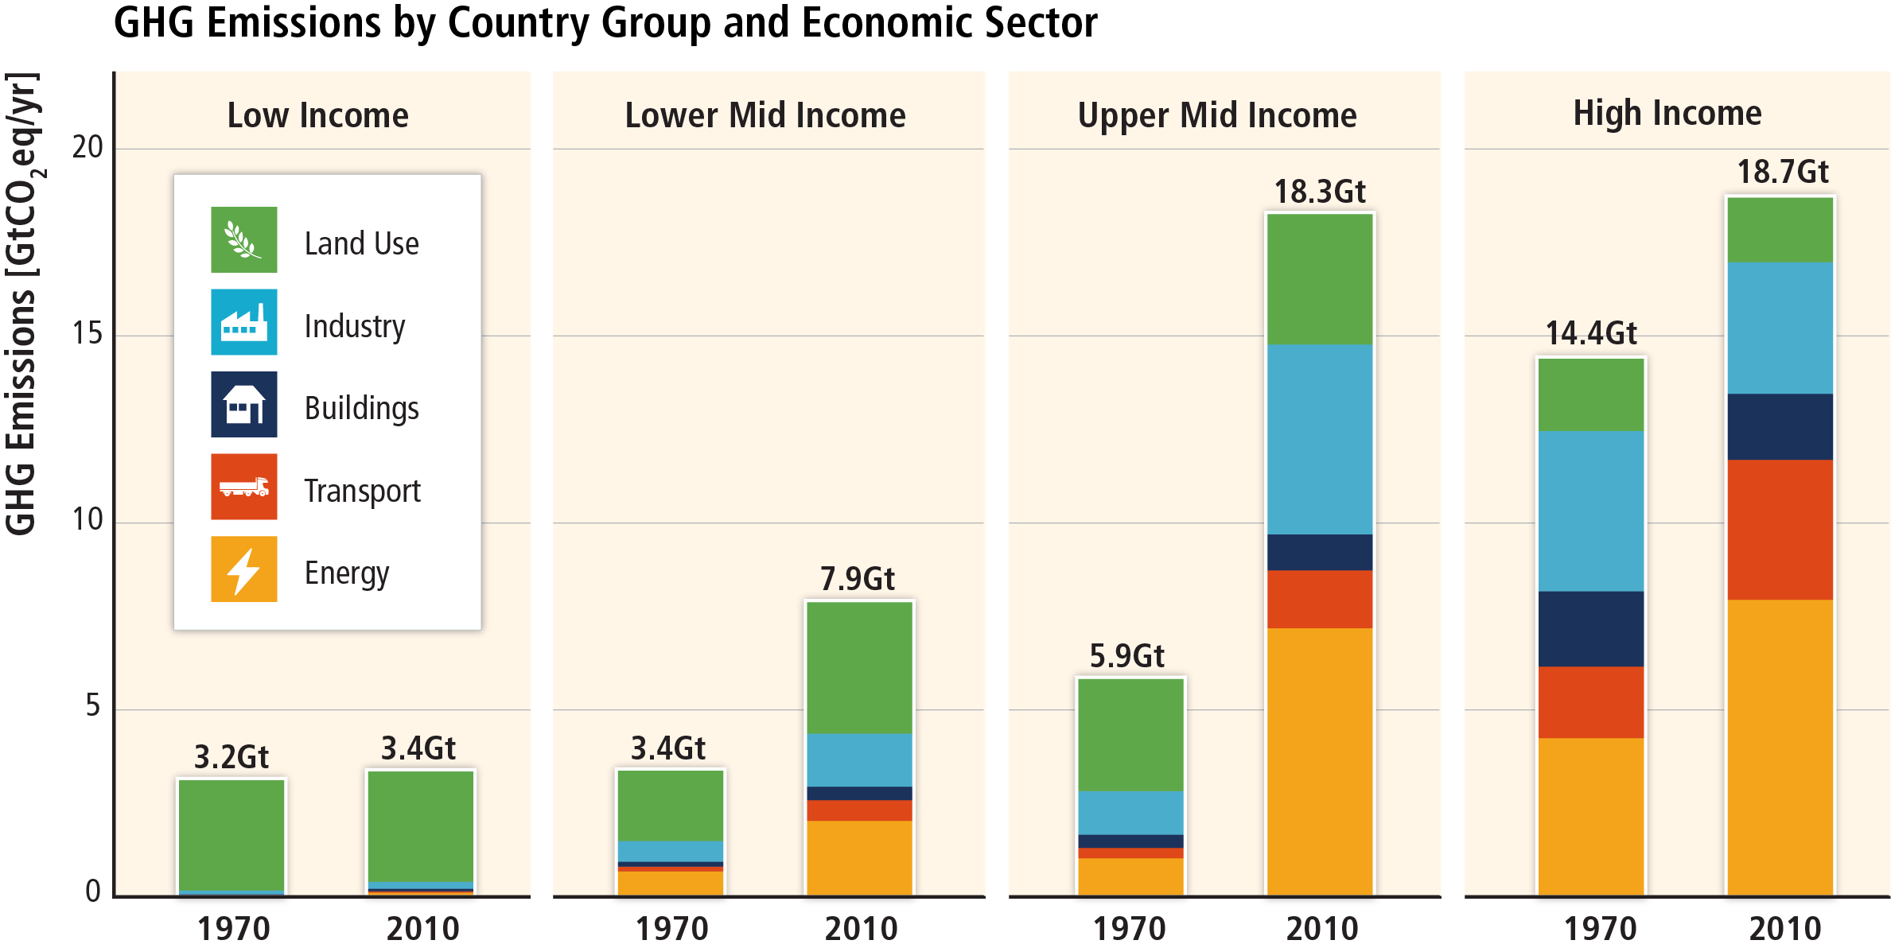
Regional patterns of GHG emissions are shifting along with changes in the world economy.
Based on Figure 1.6

Slide 9
Regional patterns of GHG emissions are shifting along with changes in the world economy.
Based on Figure 1.6

Slide 10
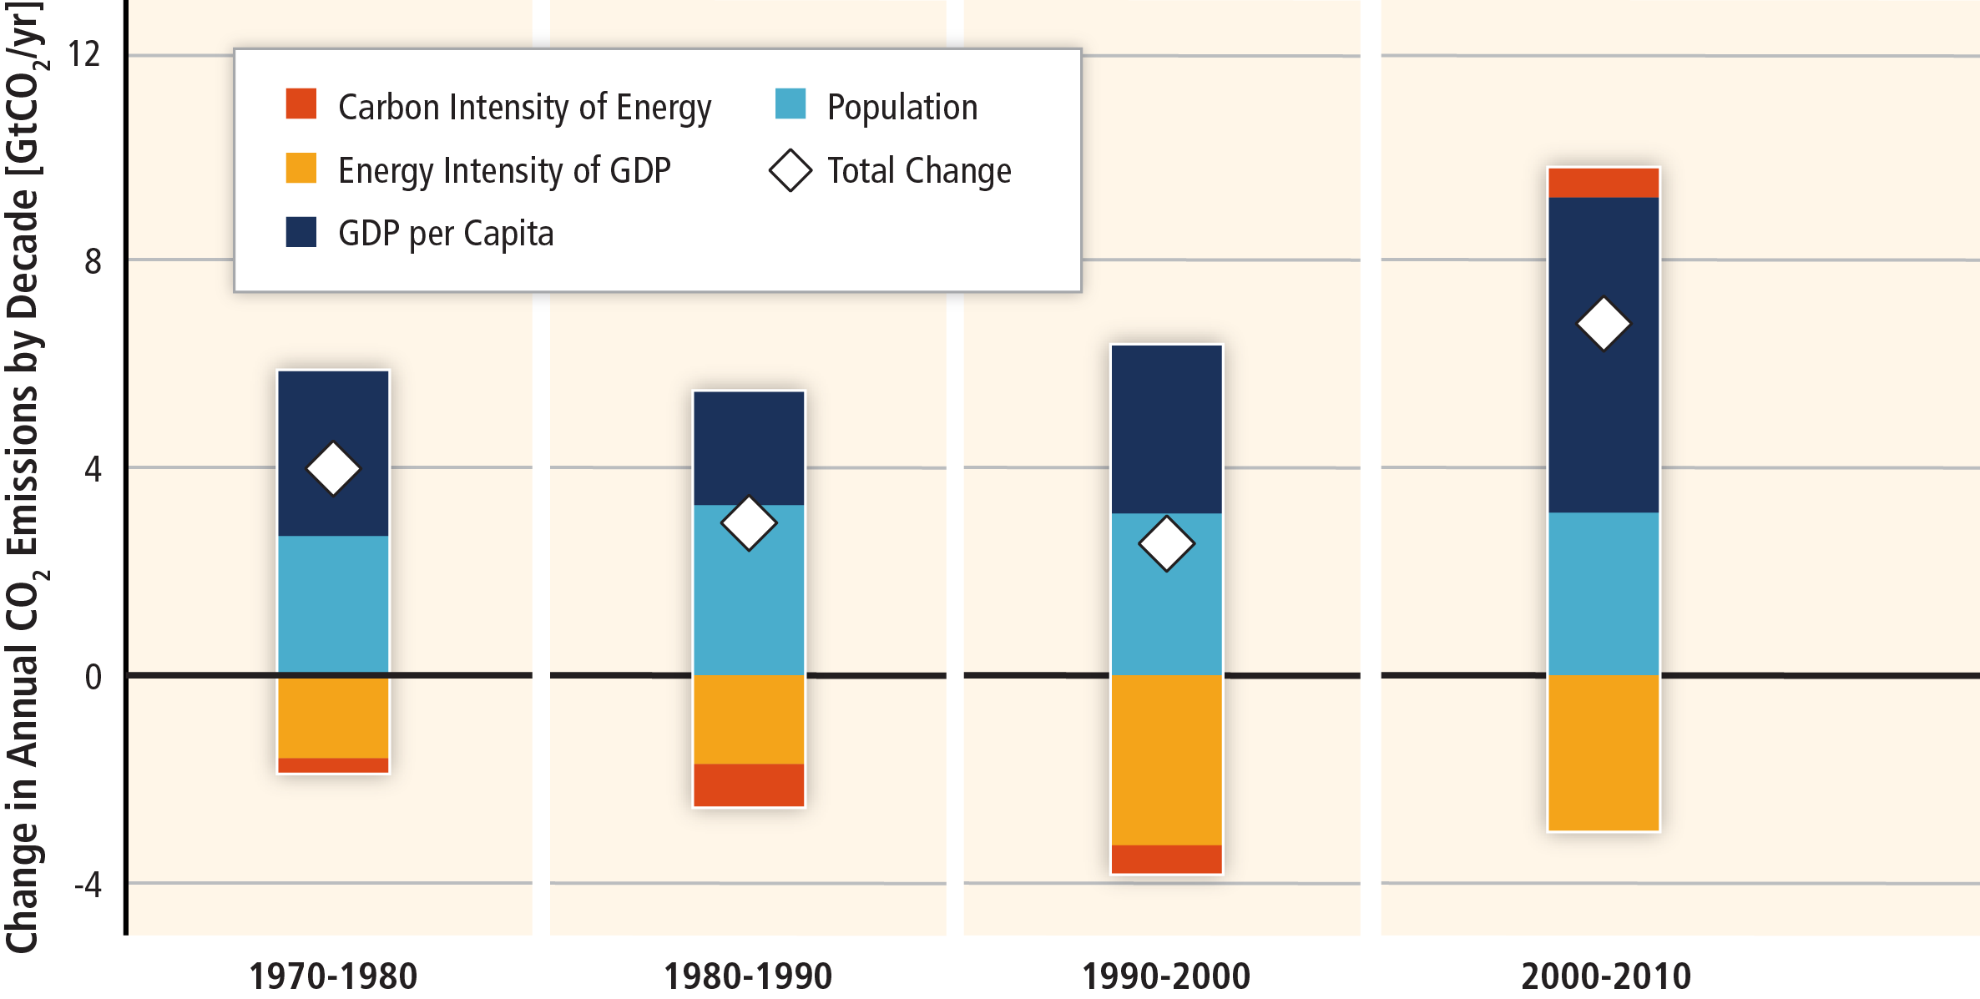
GHG emissions rise with growth in GDP and population.
Based on Figure SPM.3

Slide 11
The long-standing trend of decarbonization has reversed.
Based on Figure SPM.3

Slide 12
Limiting warming involves substantial technological, economic and institutional challenges.

Slide 13
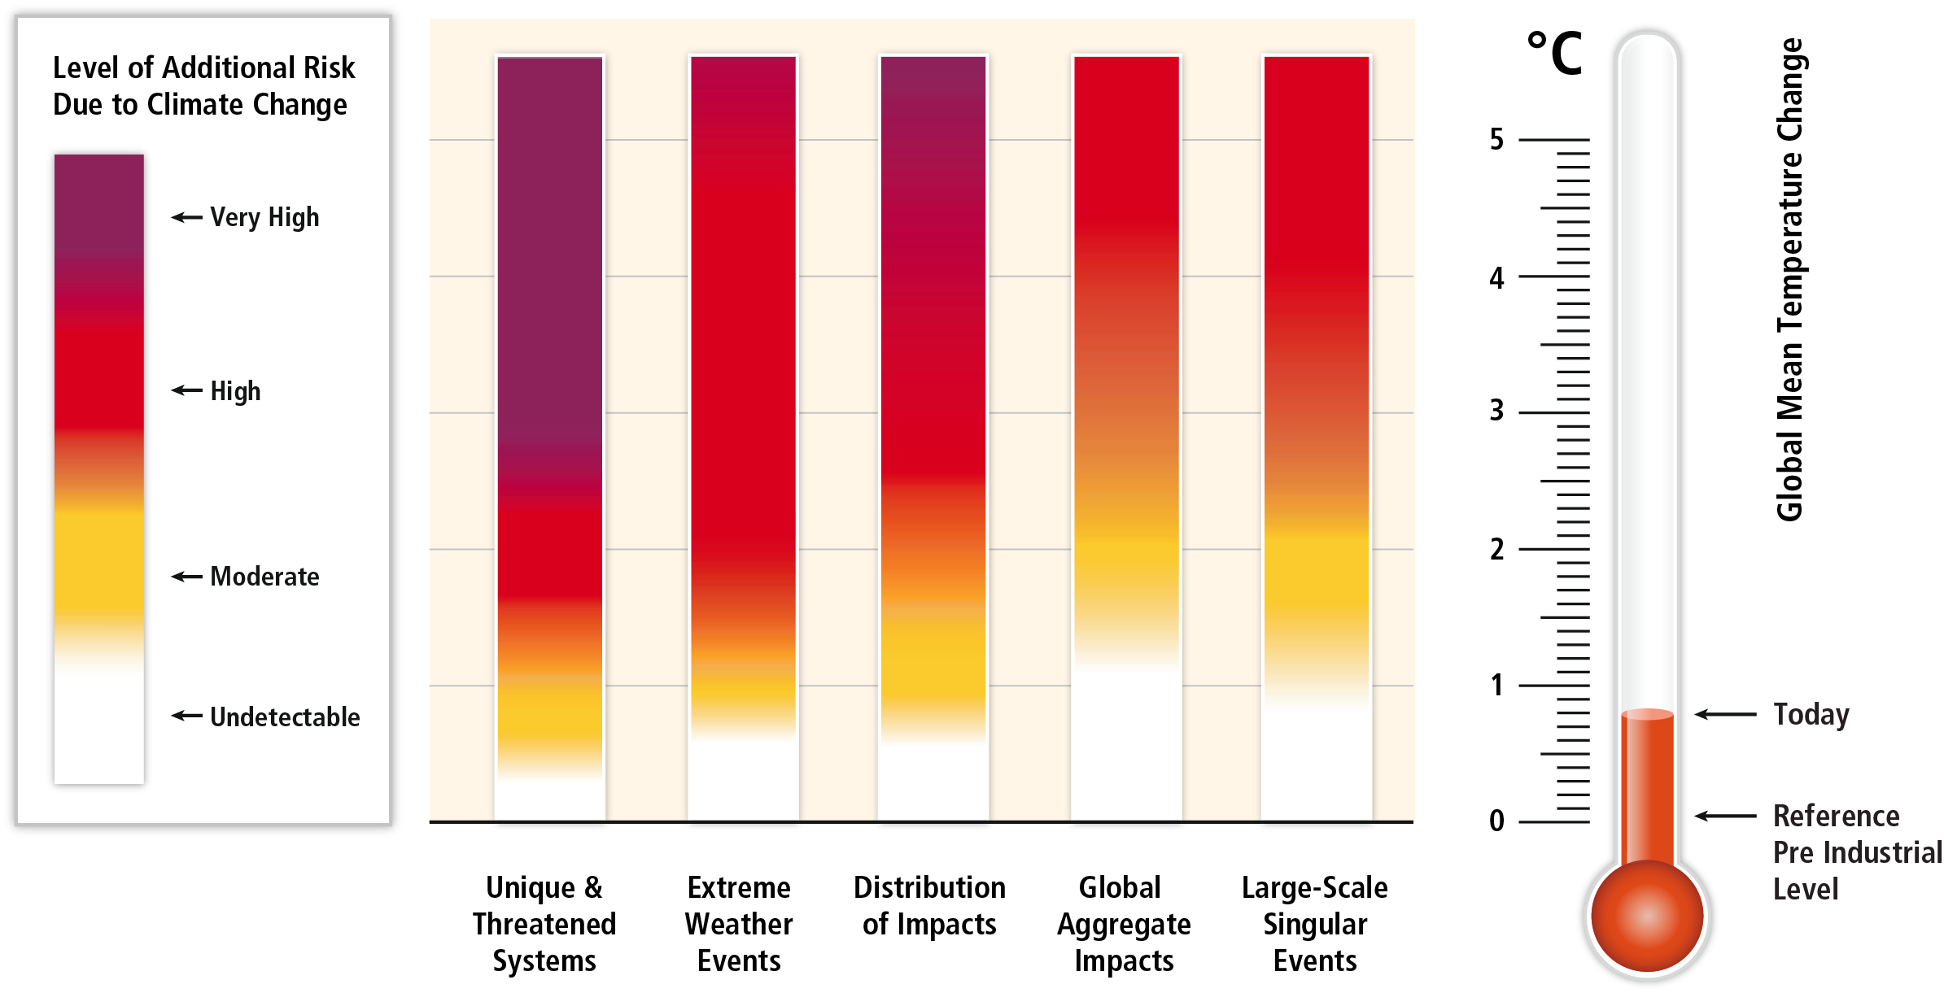
Without additional mitigation, global mean surface temperature is projected to increase by 3.7 to 4.8°C over the 21st century.
Based on WGII AR5 Figure 19.4

Slide 14
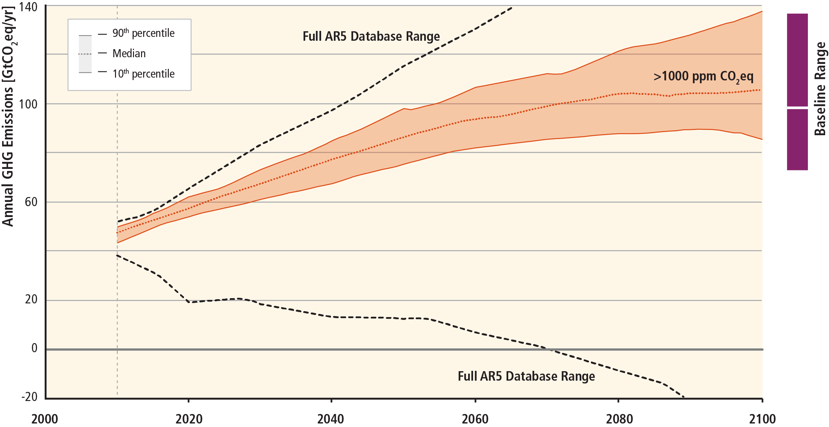
Stabilization of atmospheric GHG concentrations requires moving away from business as usual.
Based on Figure SPM.4

Slide 15
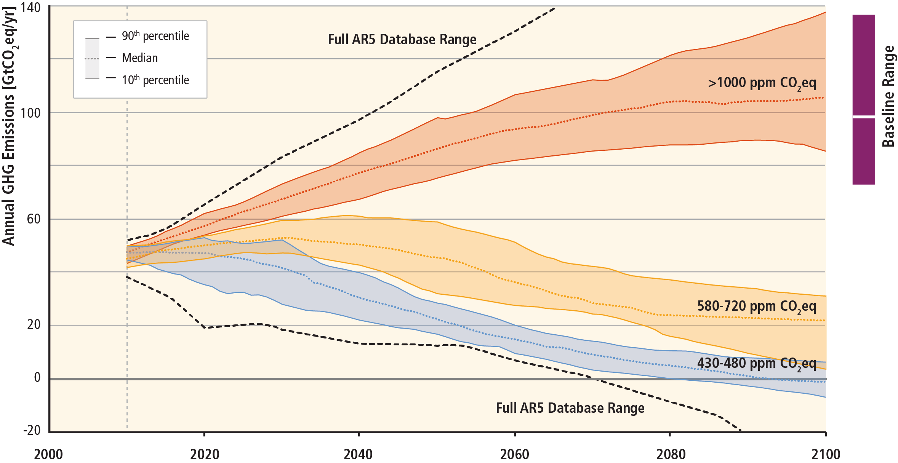
Lower ambition mitigation goals require similar reductions of GHG emissions.
Based on Figure SPM.4

Slide 16
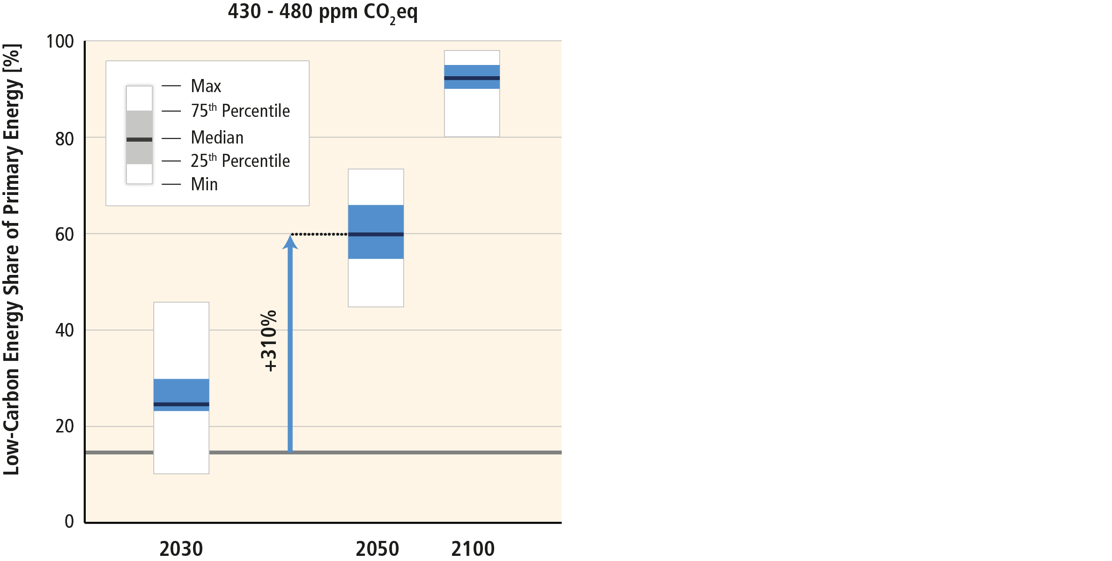
Mitigation involves substantial upscaling of low-carbon energy.
Based on Figure SPM.4

Slide 17
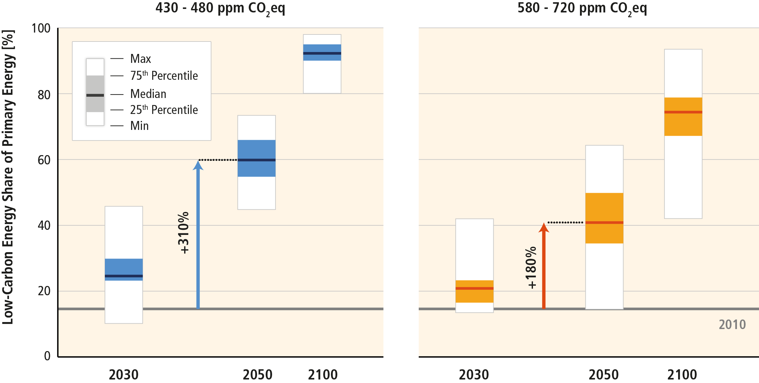
Mitigation involves substantial upscaling of low-carbon energy.
Based on Figure SPM.4

Slide 18
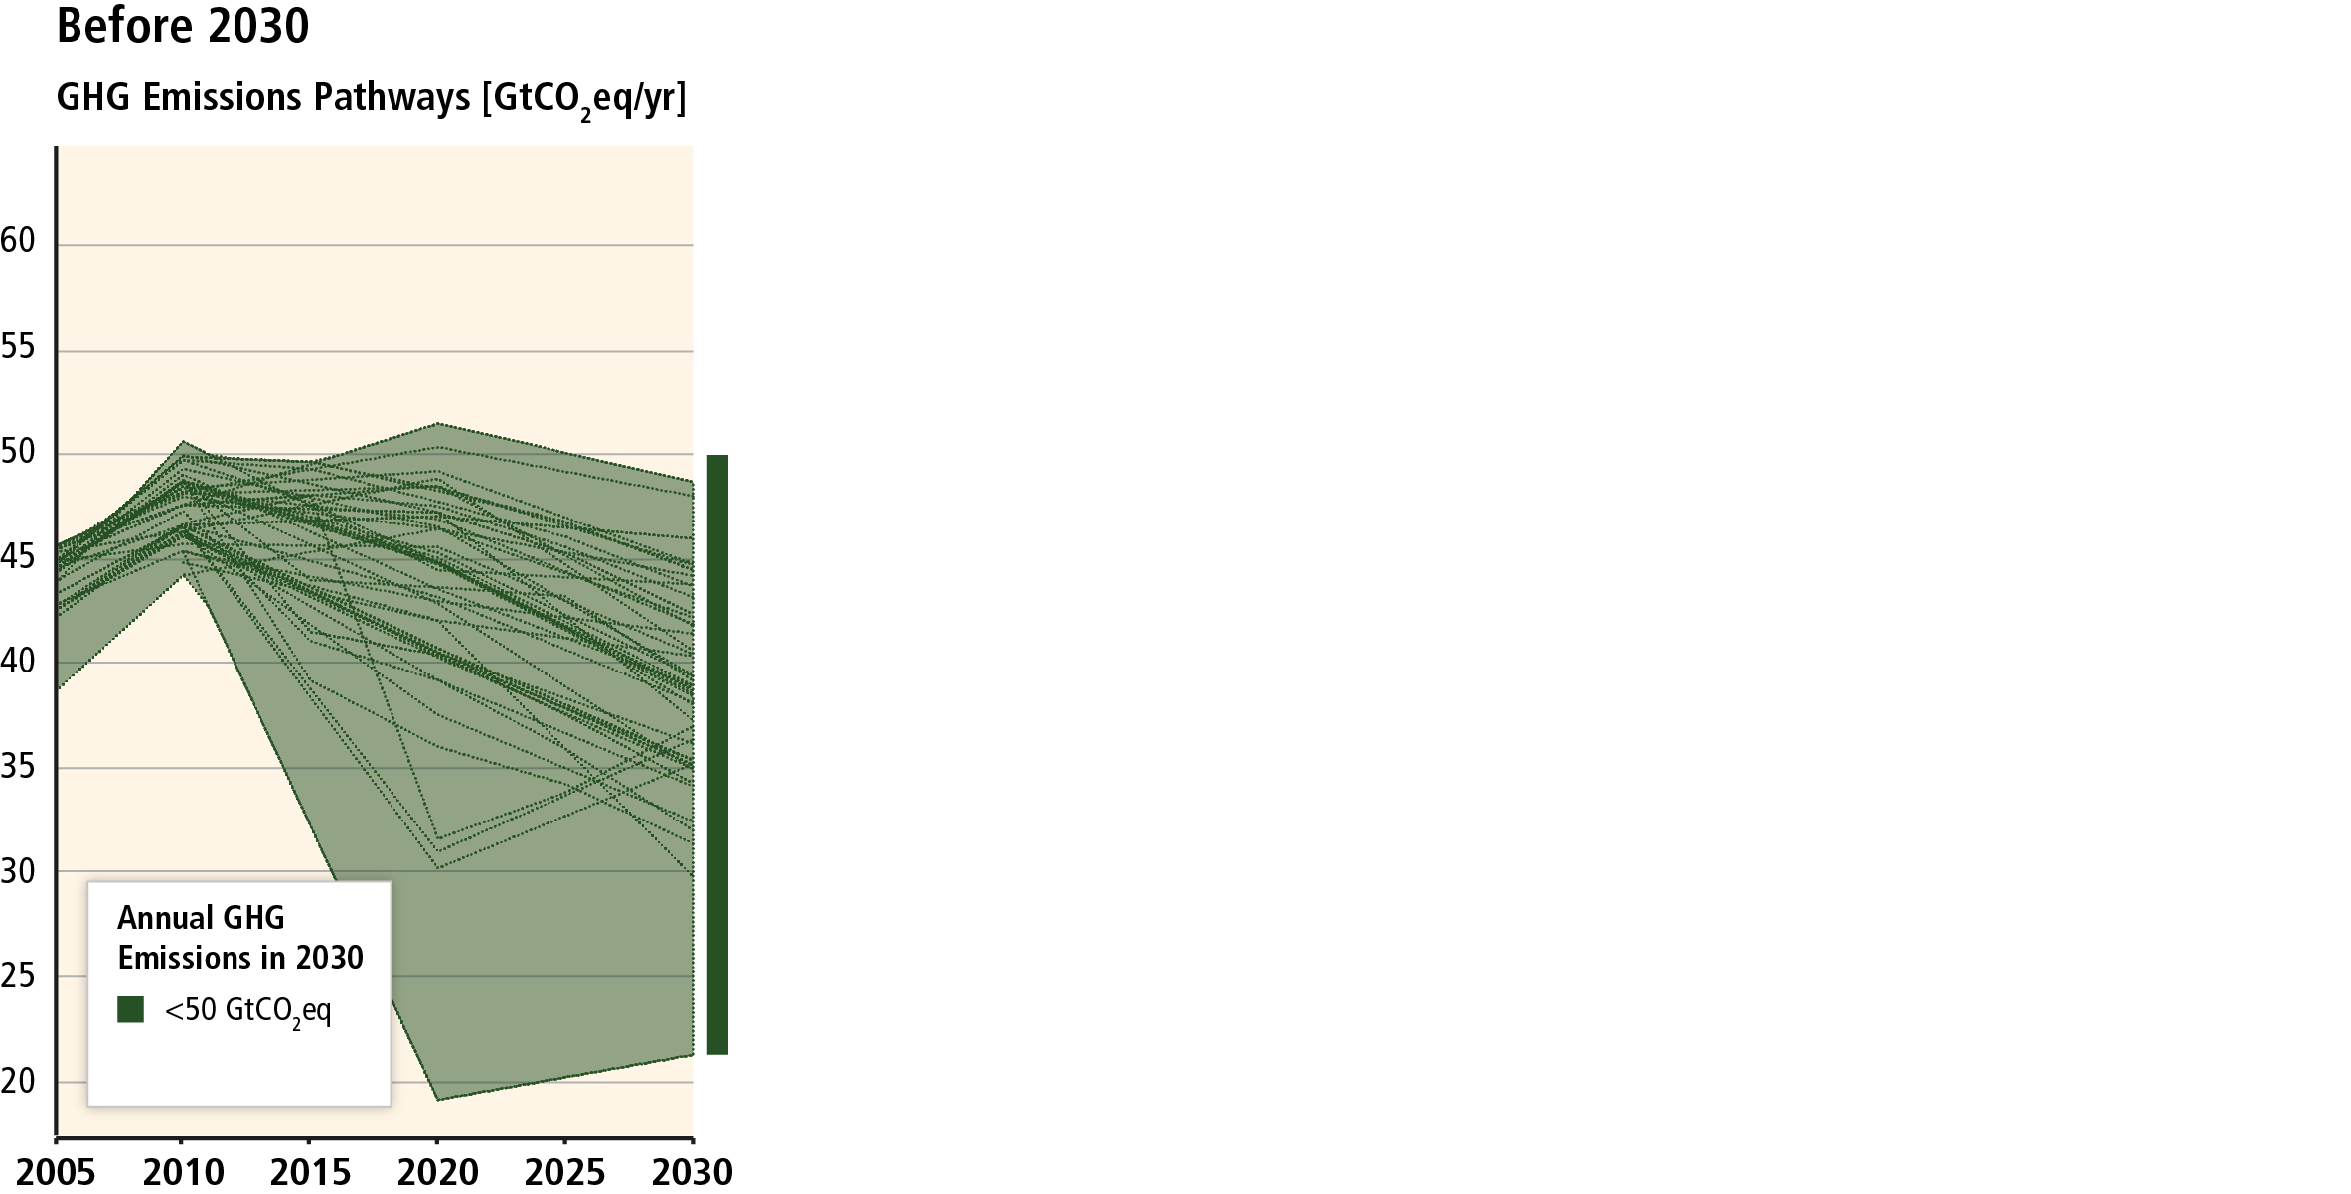
Many scenarios make it at least about as likely as not that warming will remain below 2°C relative to pre-industrial levels.
Based on Figure SPM.5

Slide 19
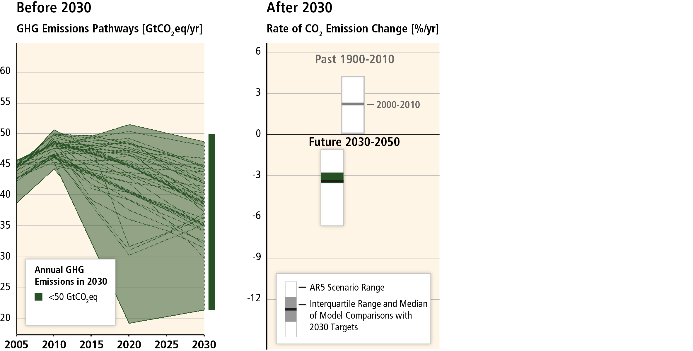
Still, between 2030 and 2050, emissions would have to be reduced at an unprecedented rate...
Based on Figure SPM.5

Slide 20
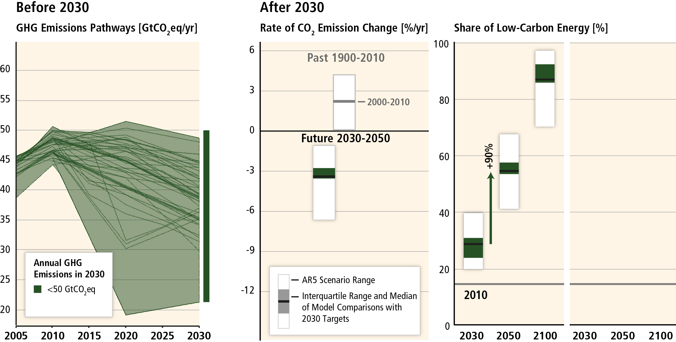
...implying a rapid scale-up of low-carbon energy.
Based on Figure SPM.5

Slide 21
Delaying emissions reductions increases the difficulty and narrows the options for mitigation.
Based on Figure SPM.5

Slide 22
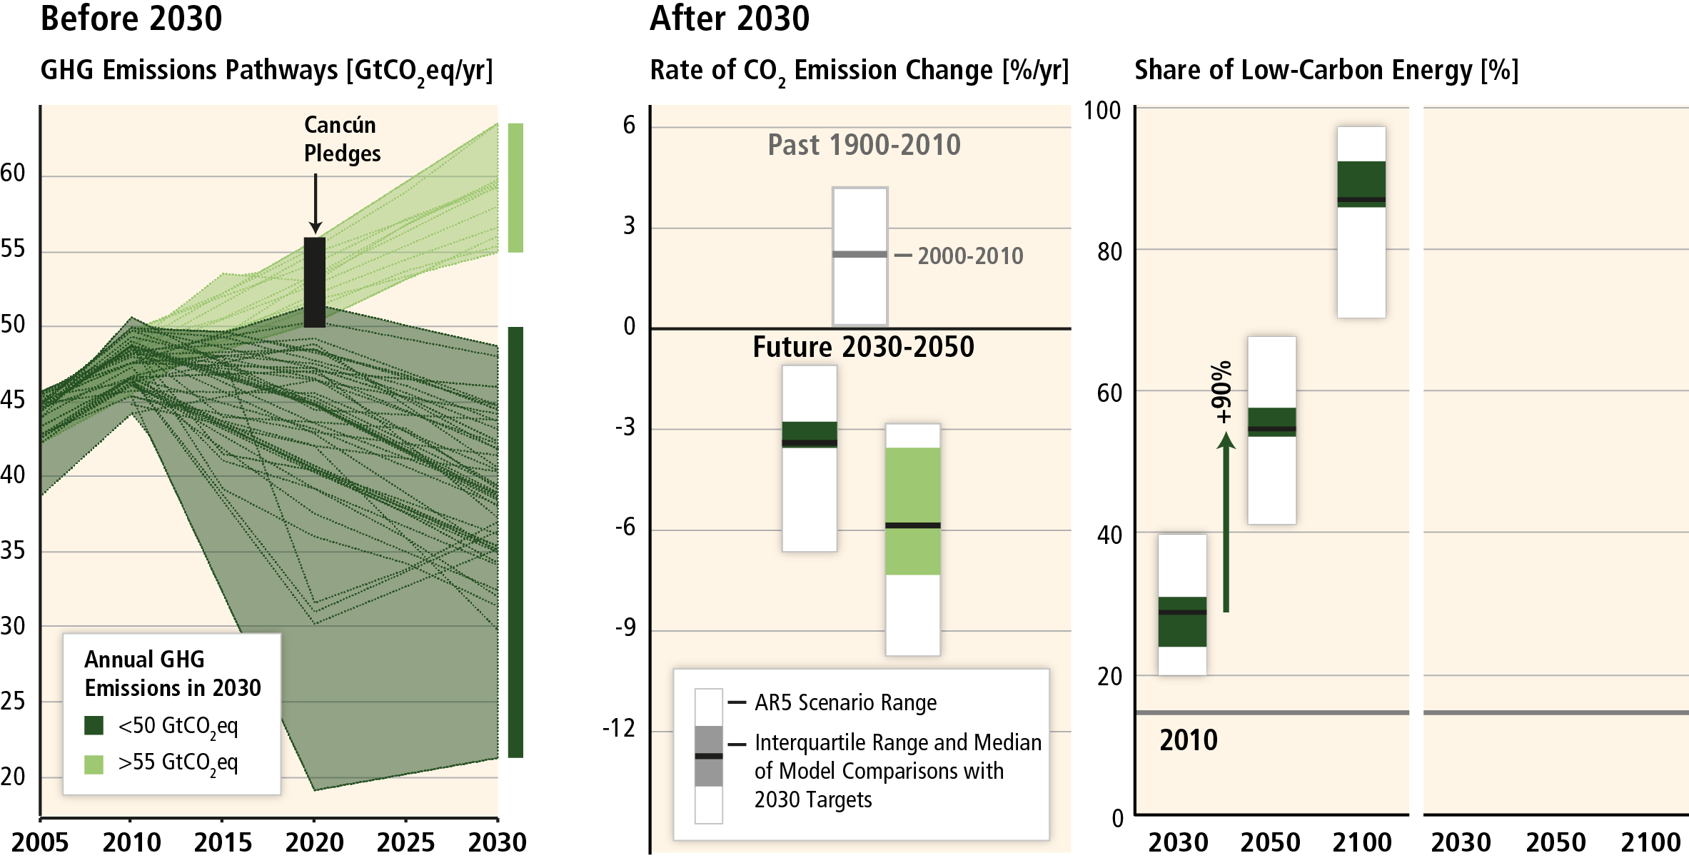
Delaying emissions reductions increases the difficulty and narrows the options for mitigation.
Based on Figure SPM.5

Slide 23
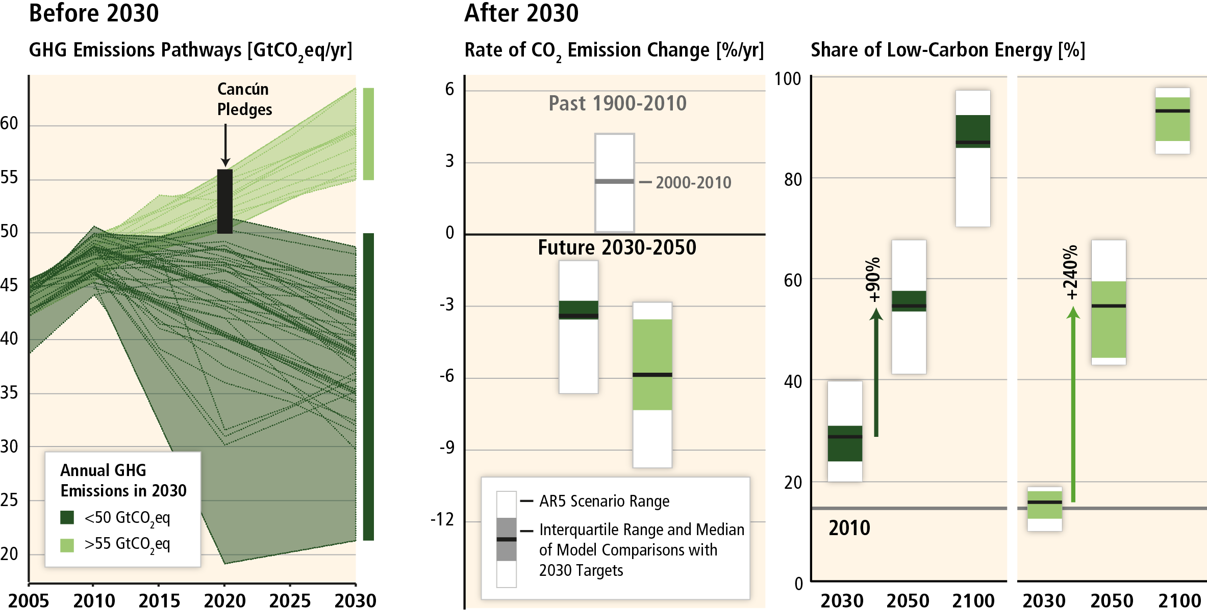
Delaying emissions reductions increases the difficulty and narrows the options for mitigation.
Based on Figure SPM.5

Slide 24
Mitigation cost estimates vary, but global GDP growth may not be strongly affected.

Slide 25
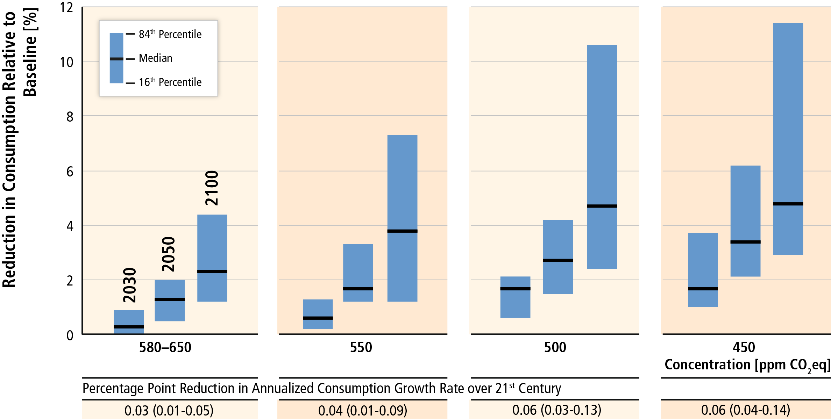
Global costs rise with the ambition of the mitigation goal.
Based on Table SPM.2

Slide 26
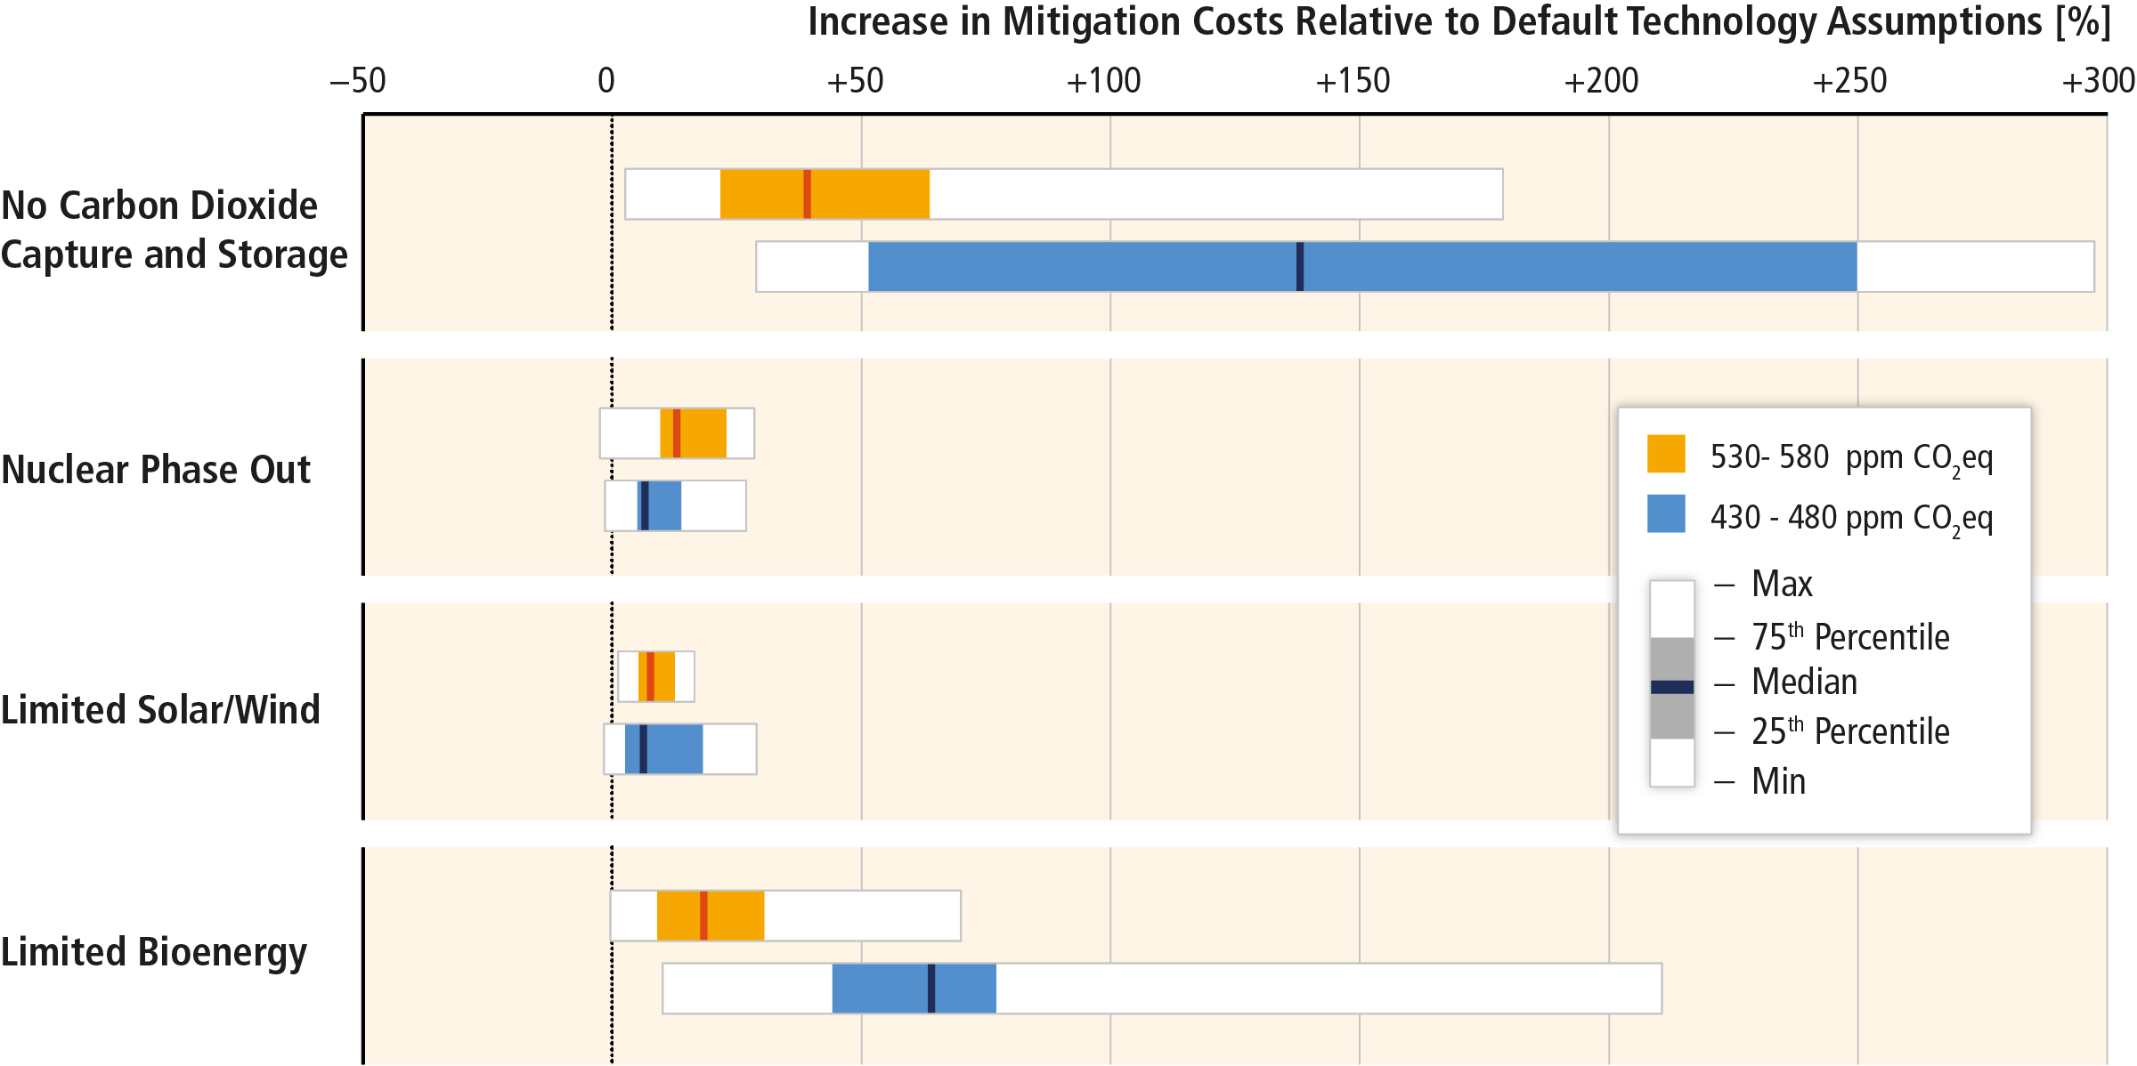
Technological limitations can increase mitigation costs.
Based on Figure 6.24

Slide 27
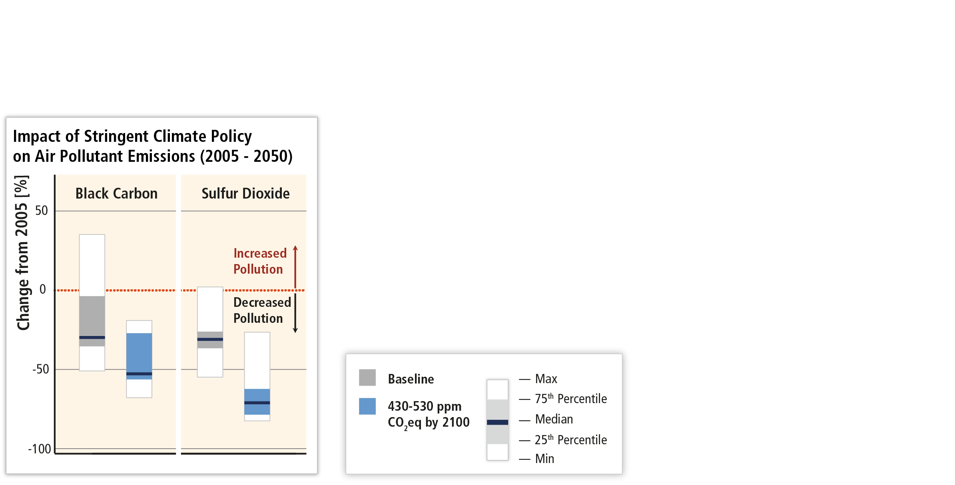
Mitigation can result in co-benefits for human health and other societal goals.
Based on Figures SPM.6 and 12.23

Slide 28
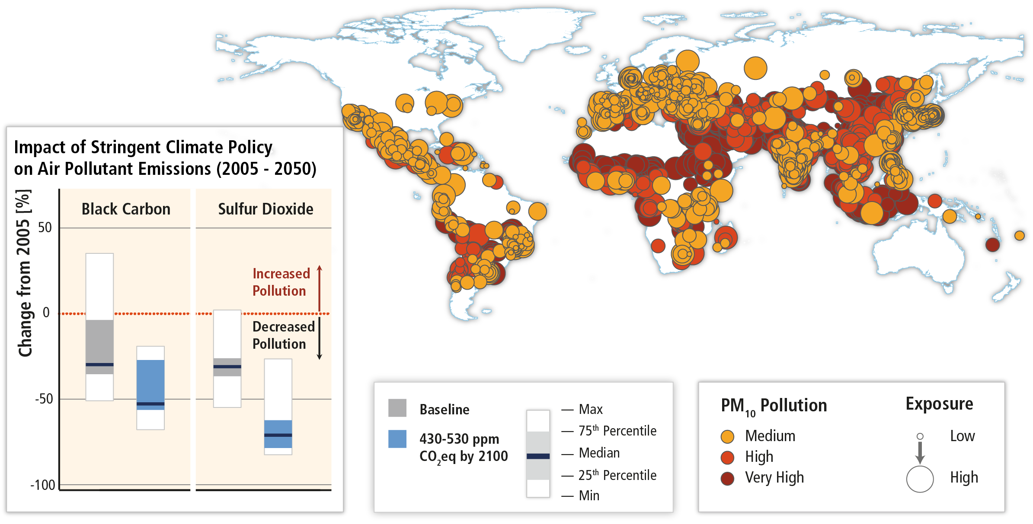
Climate change mitigation can result in co-benefits for human health and other societal goals.
Based on Figures SPM.6 and 12.23

Slide 29
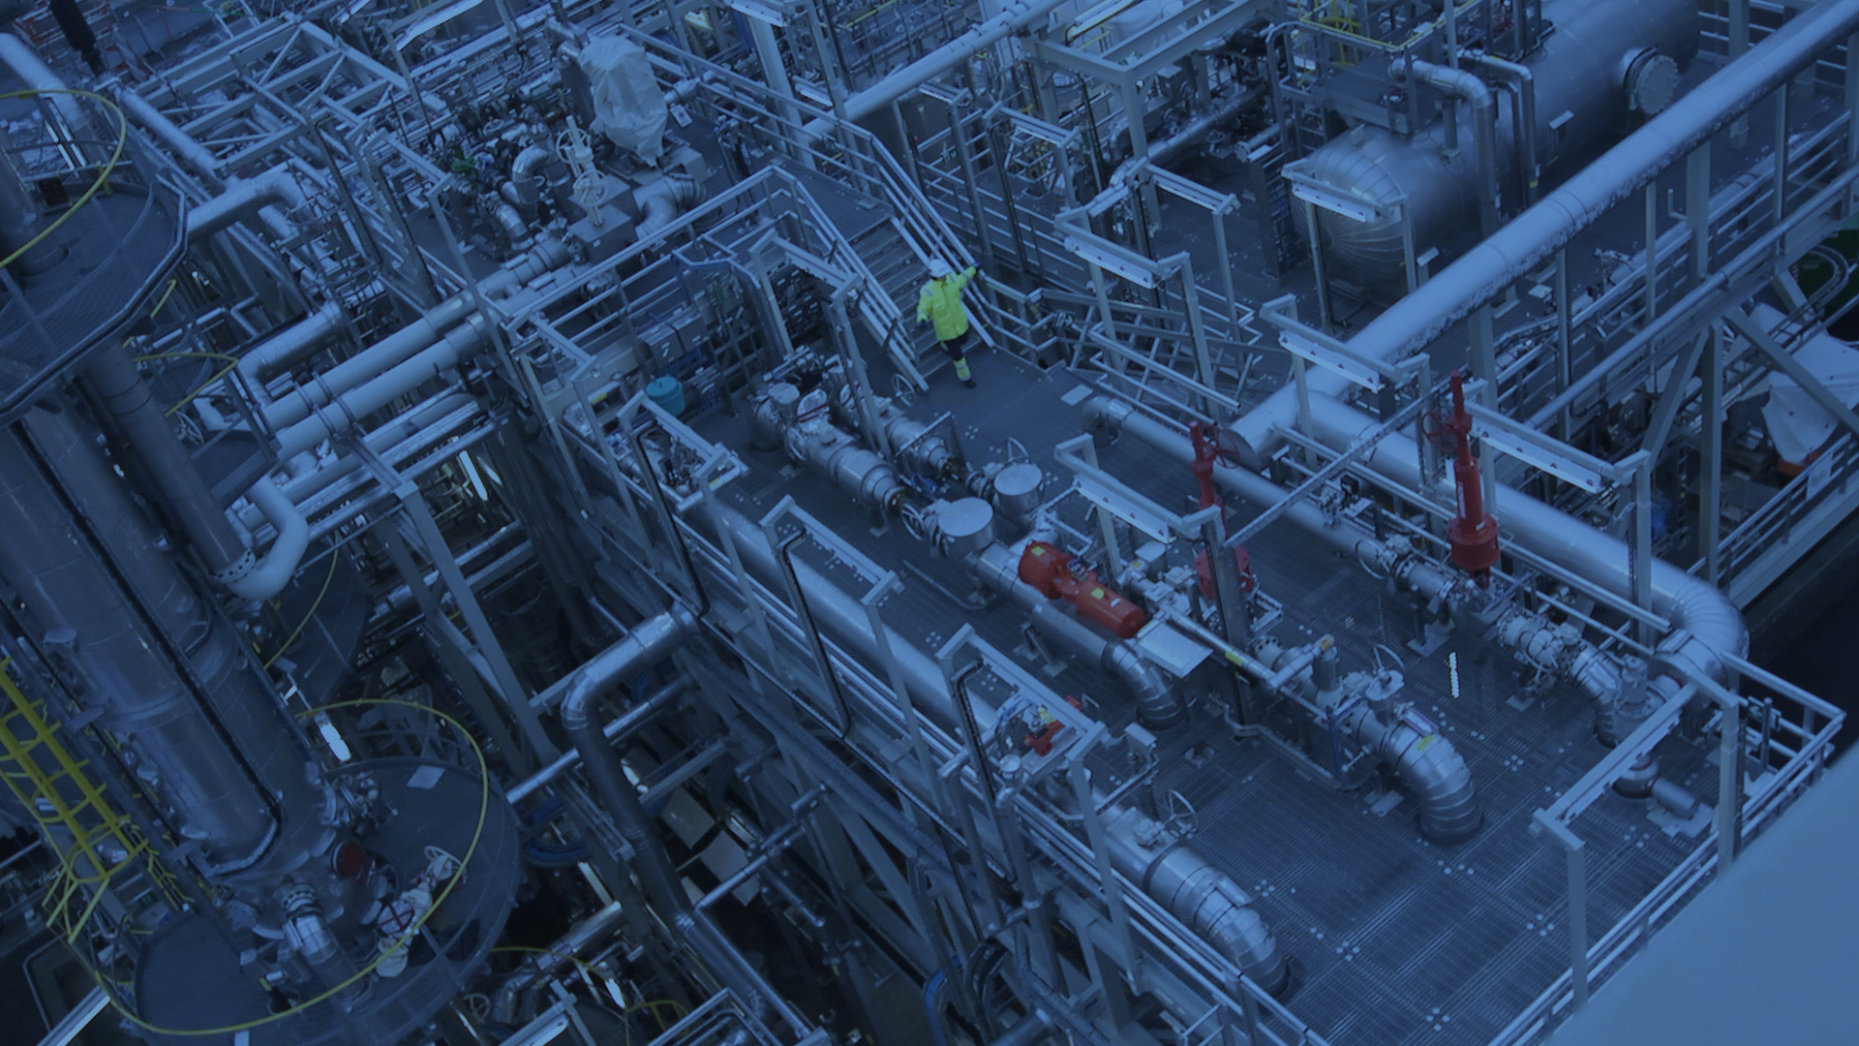
Low stabilization scenarios depend on a full decarbonization of energy supply.

Slide 30
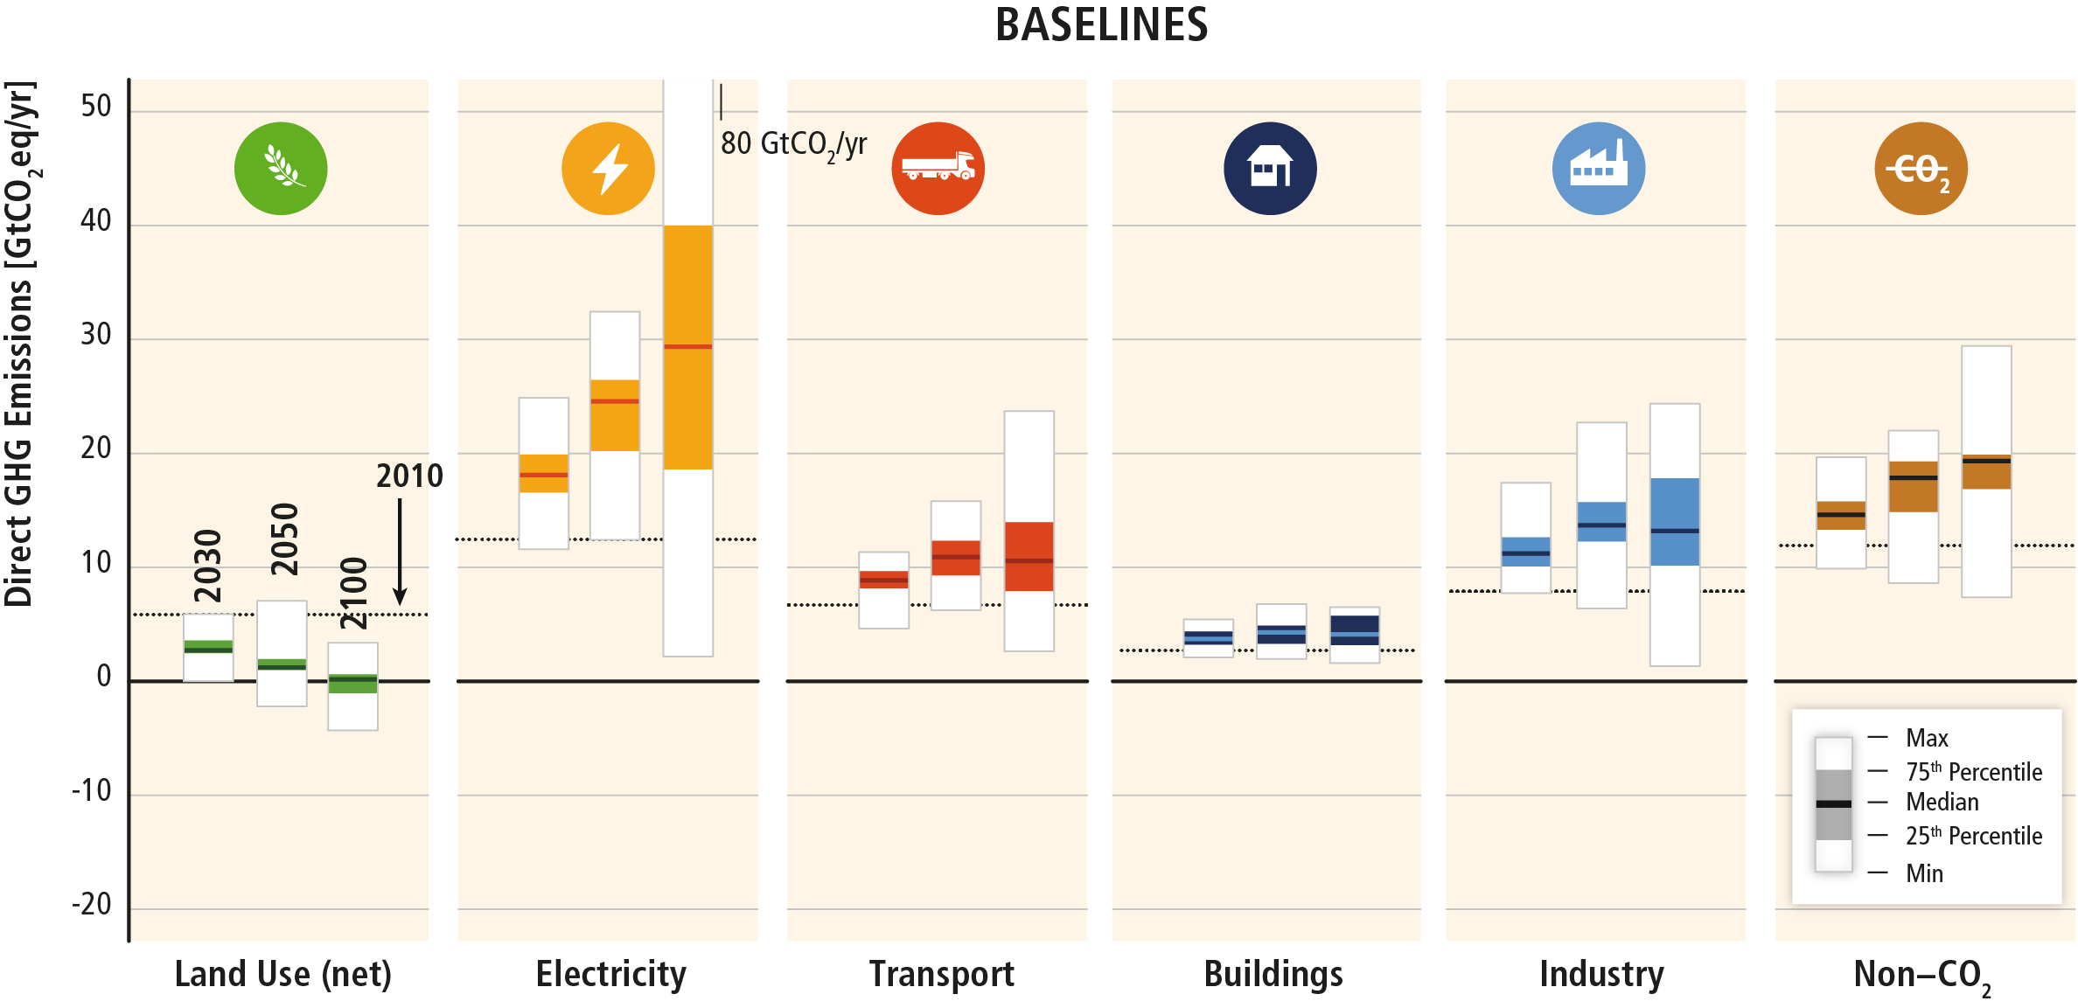
Baseline scenarios suggest rising GHG emissions in all sectors, except for CO₂ emissions from the land‐use sector.
Based on Figure TS.15

Slide 31
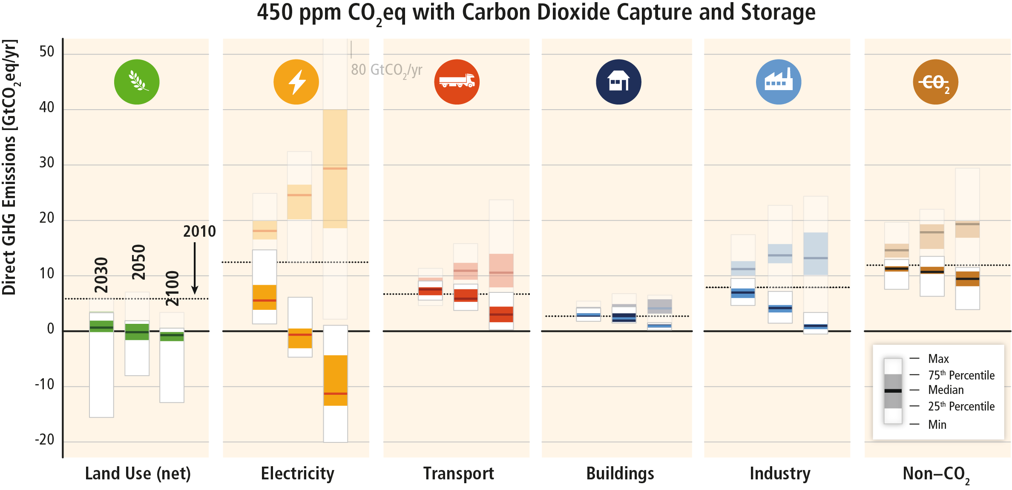
Mitigation requires changes throughout the economy. Systemic approaches are expected to be most effective.
Based on Figure TS.17

Slide 32
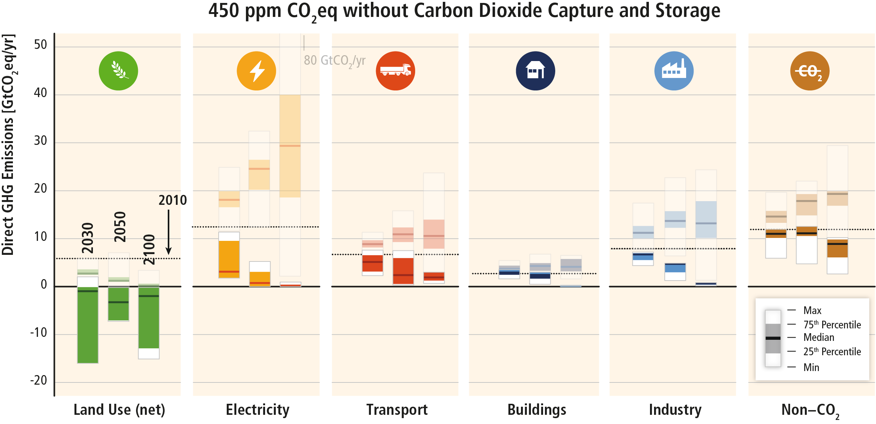
Mitigation efforts in one sector determine efforts in others.
Based on Figure TS.17

Slide 33
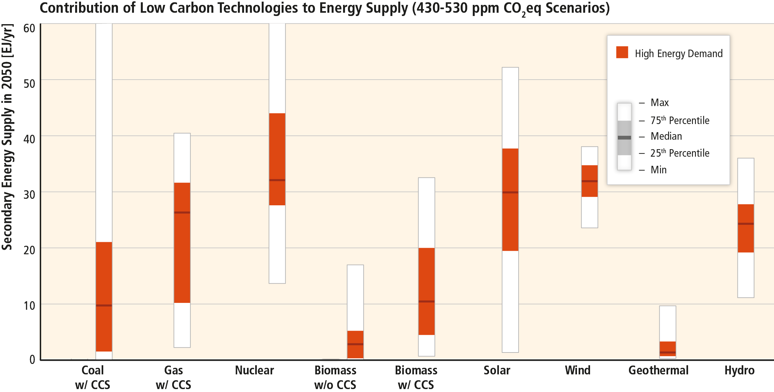
Decarbonization of energy supply is a key requirement for limiting warming to 2°C.
Based on Figure 7.11

Slide 34
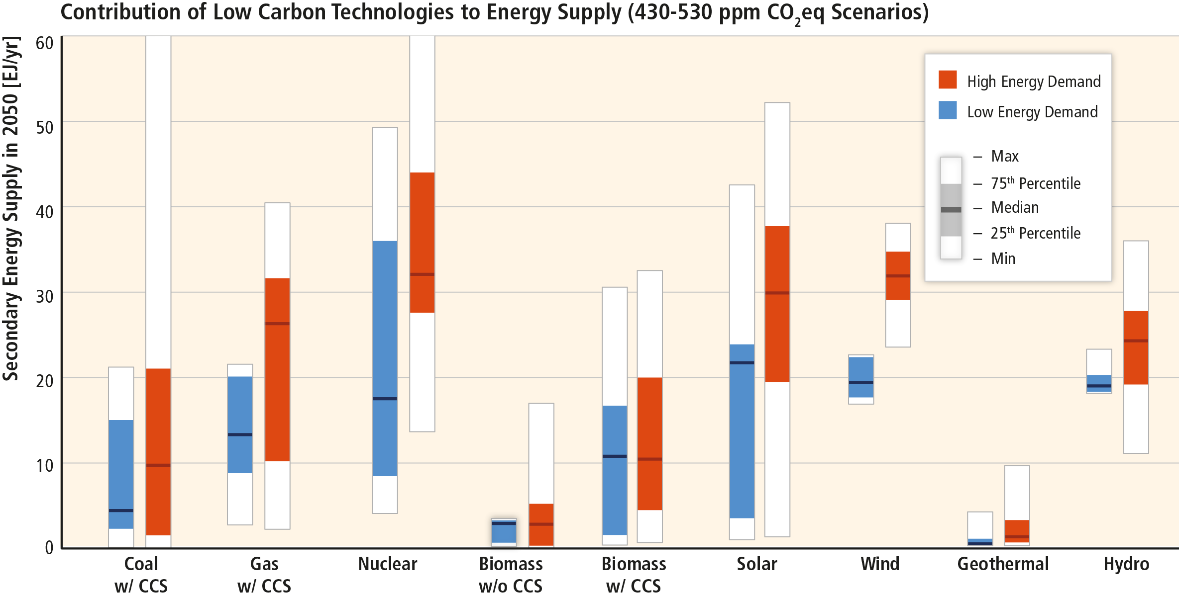
Energy demand reductions can provide flexibility, hedge against risks, avoid lock-in and provide co-benefits.
Based on Figure 7.11

Slide 35
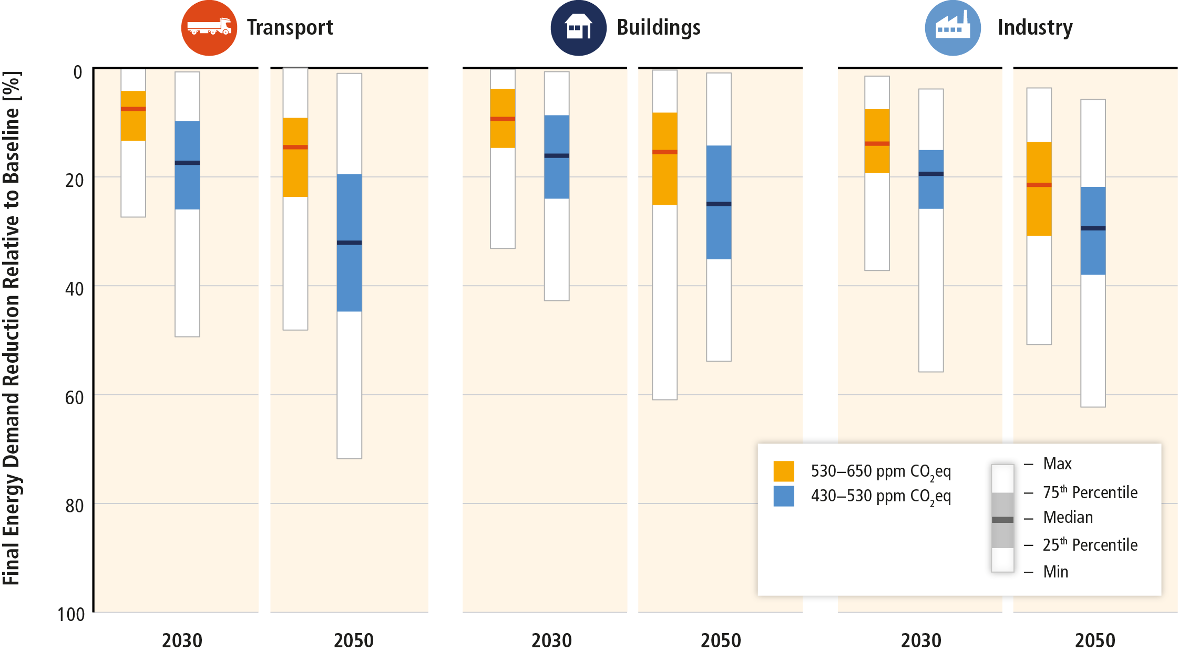
Reducing energy demand through efficiency enhancements and behavioural changes is a key mitigation strategy.
Based on Figure SPM.8

Slide 36
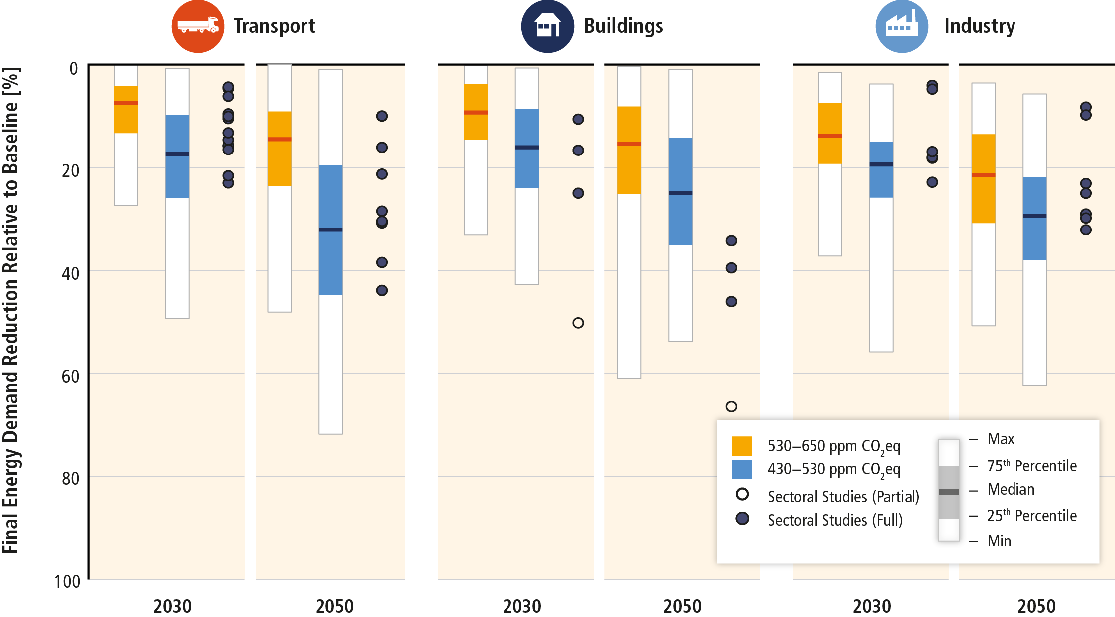
Reducing energy demand through efficiency enhancements and behavioural changes are a key mitigation strategy.
Based on Figure SPM.8

Slide 37
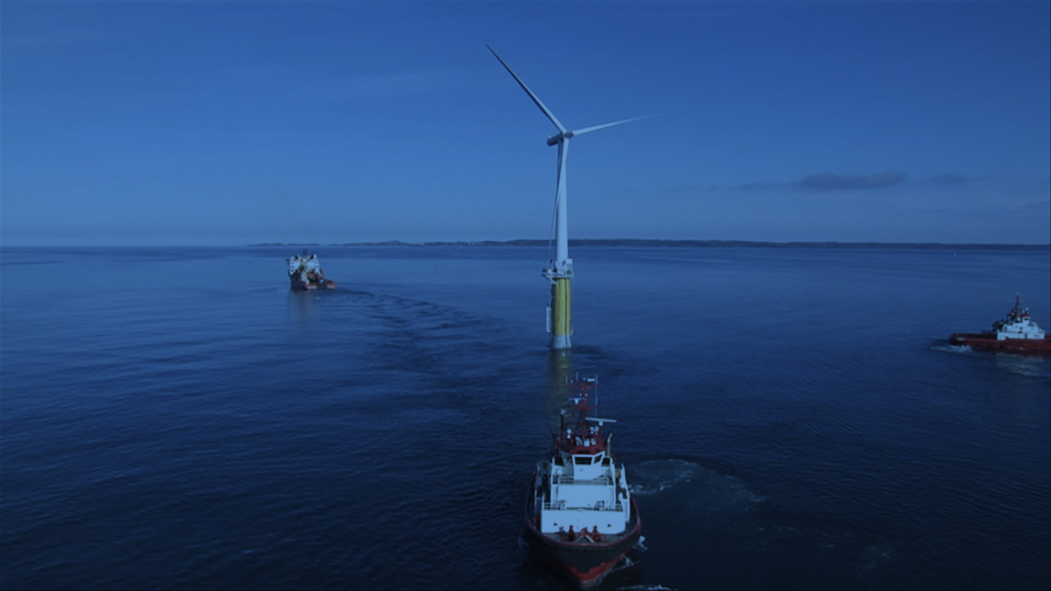
The wide-scale application of best-practice low-GHG technologies could lead to substantial emission reductions.

Slide 38
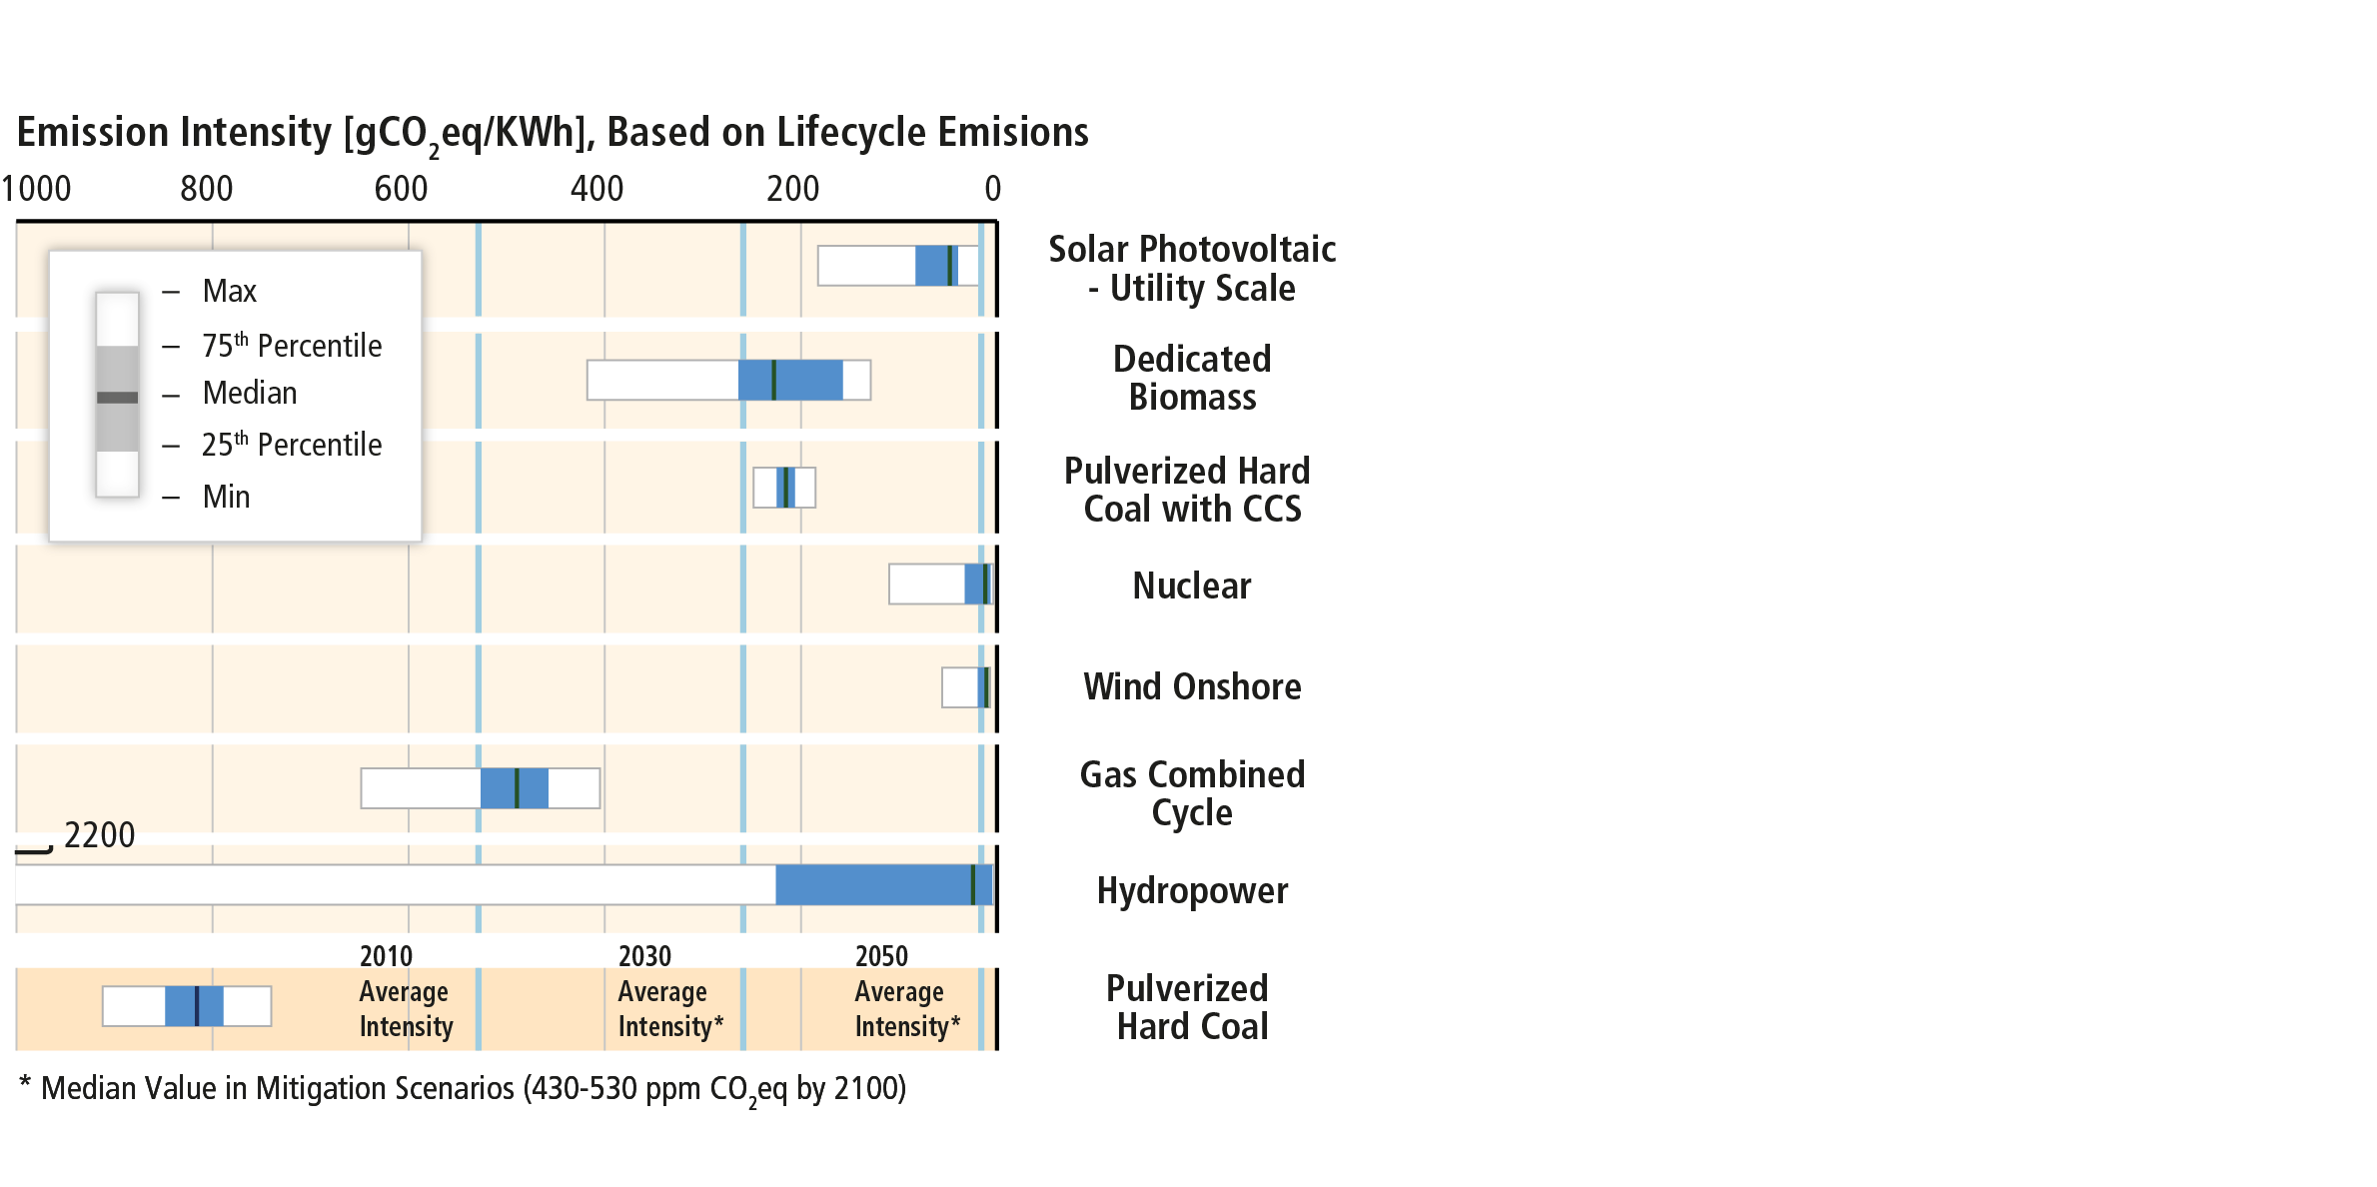
Examples from electricity generation: Low emission technologies exist, but emissions are reduced to different degrees.
Based on Figure 7.7

Slide 39
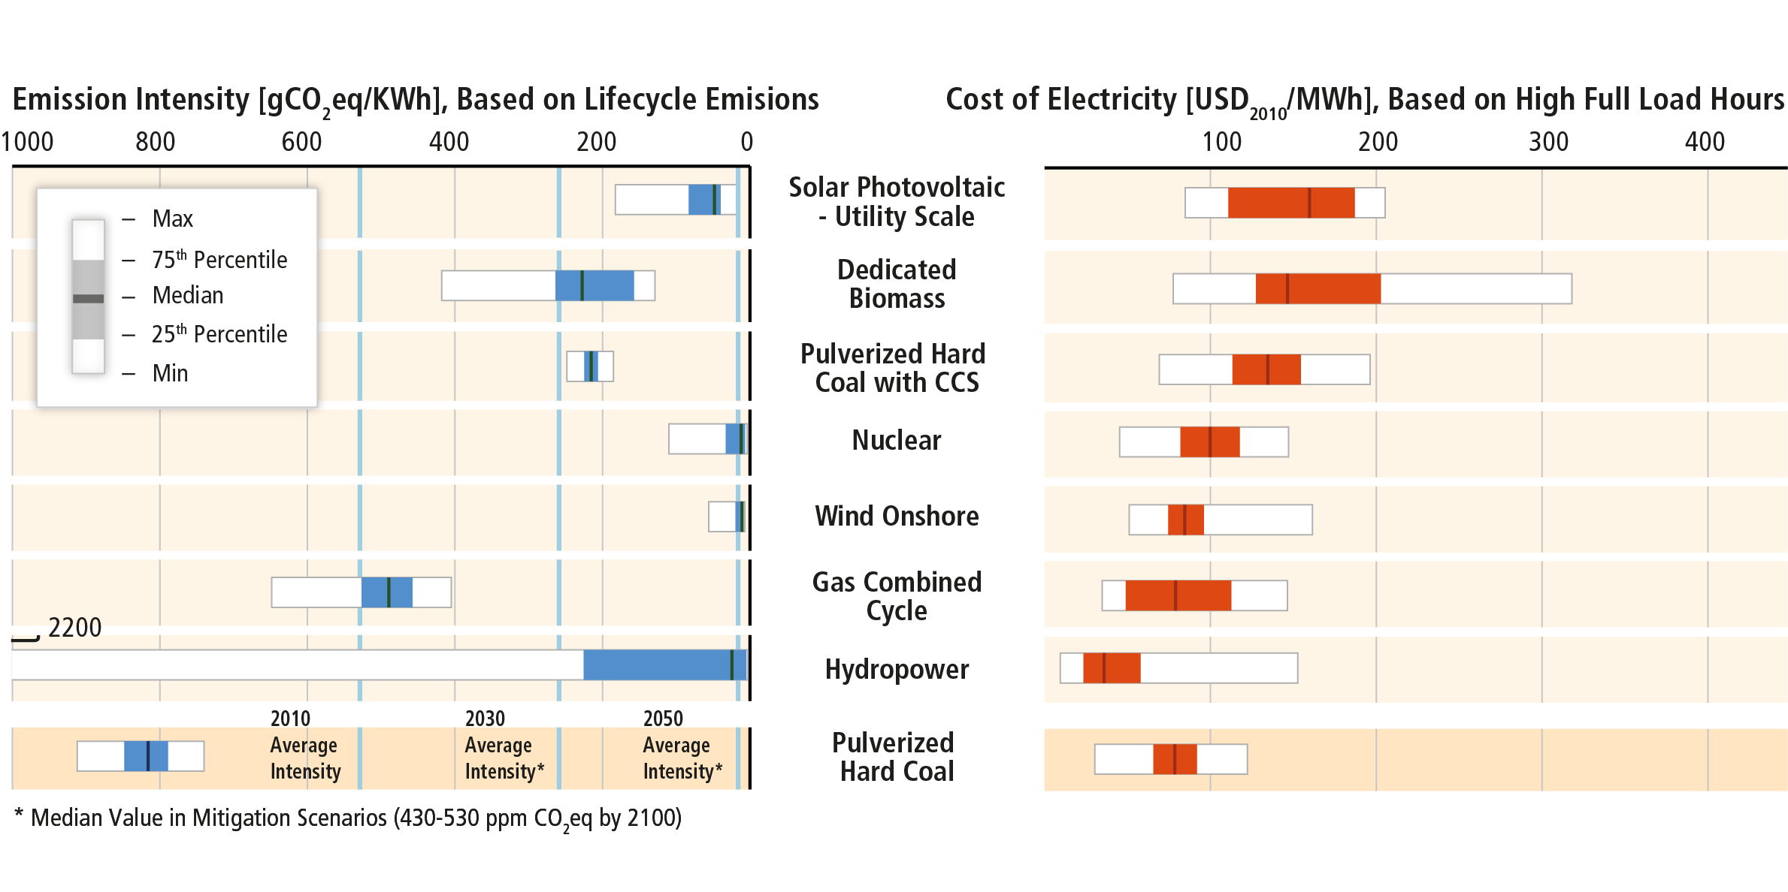
Due to cost decline, renewable energy technologies are becoming economical solutions in an increasing number of countries.
Based on Figure 7.7

Slide 40
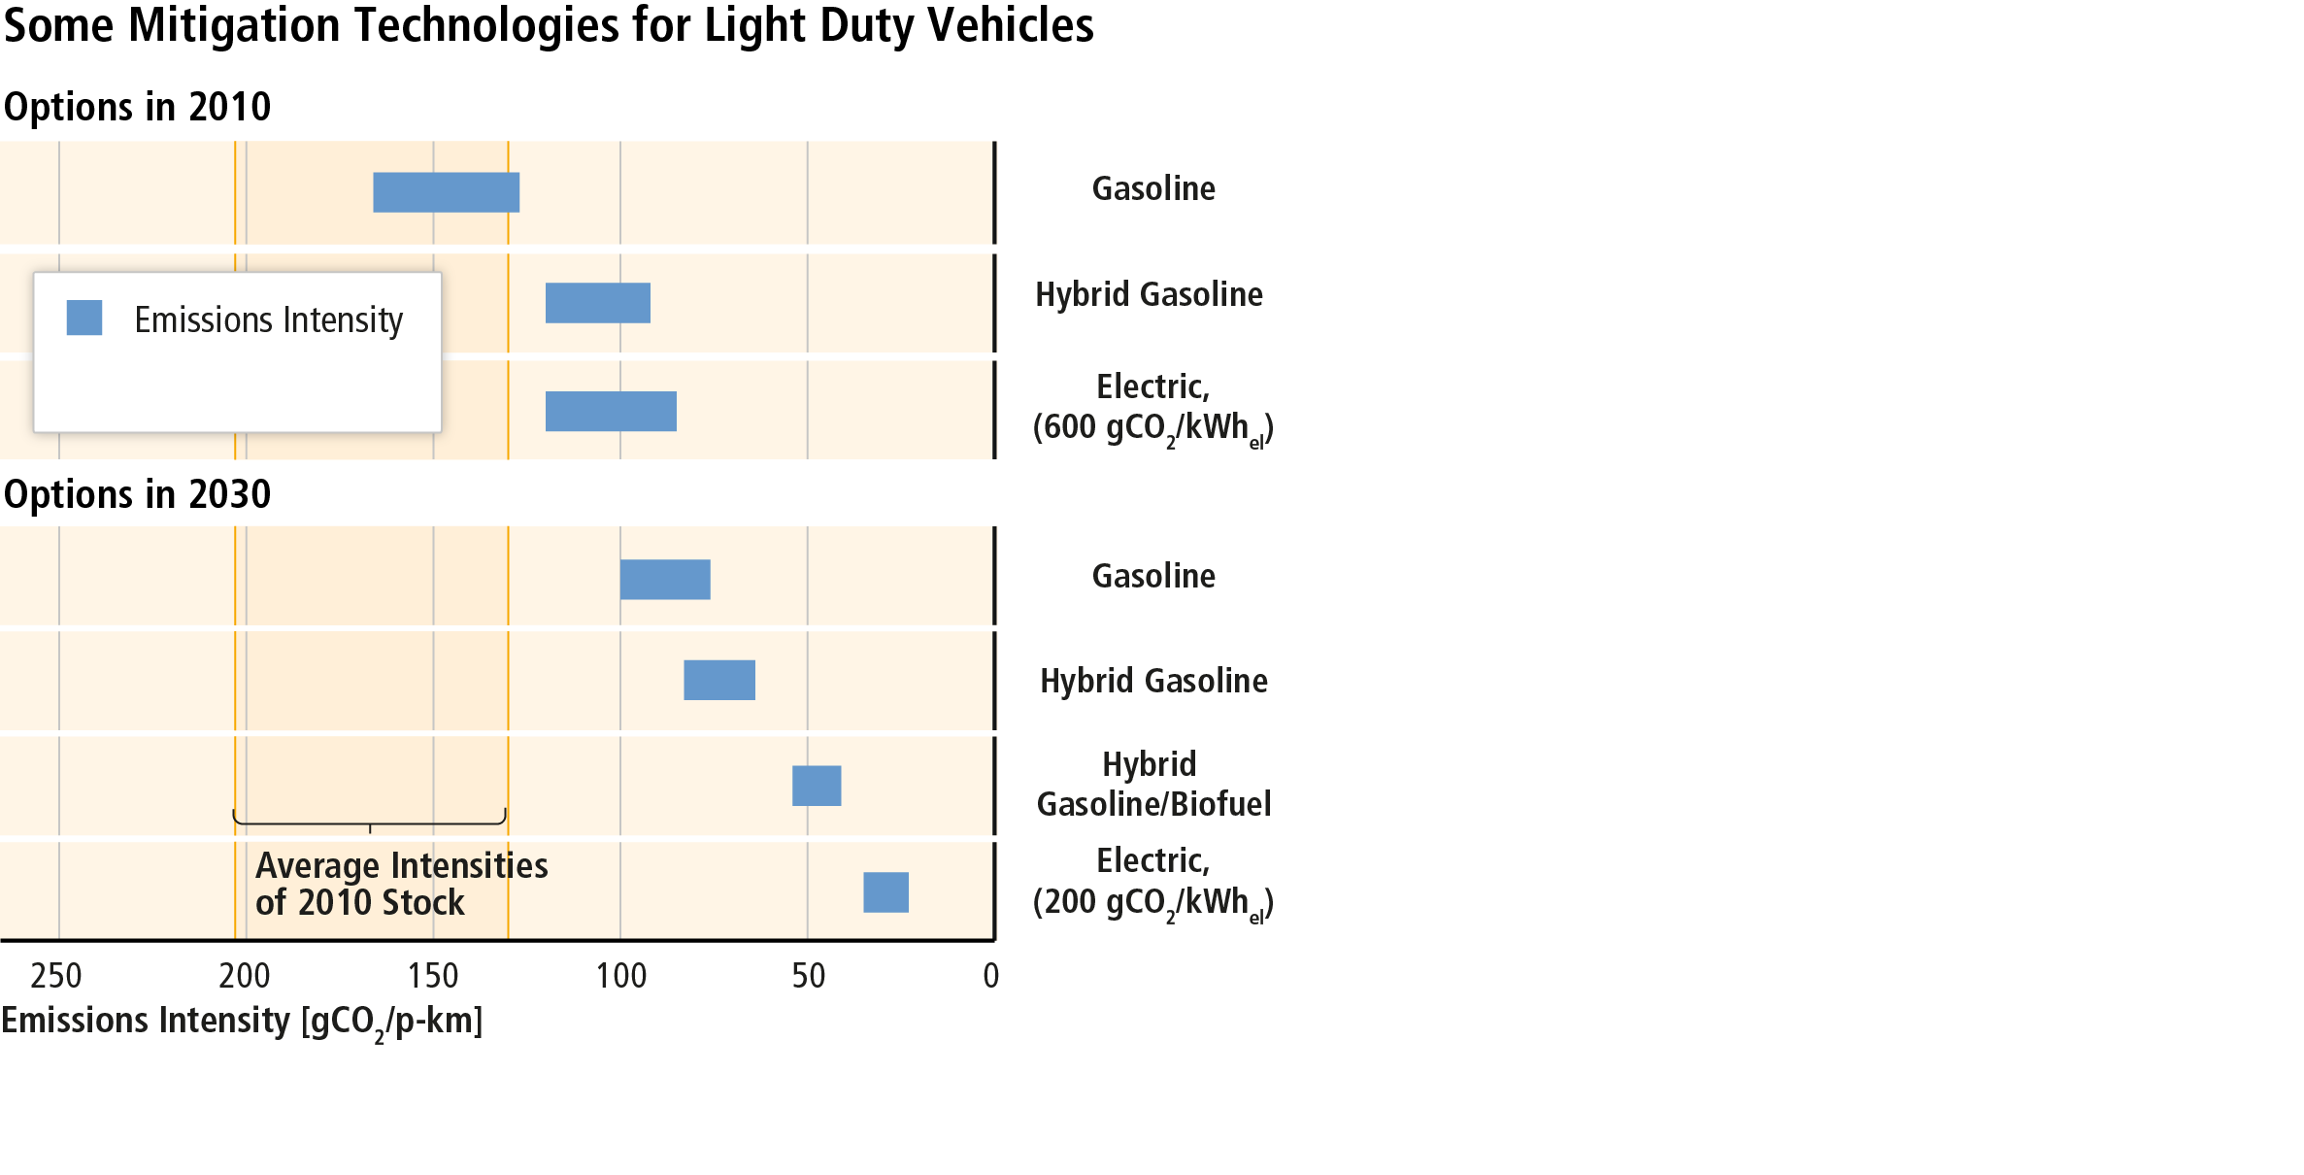
Examples from transport: Several strategies exist to reduce emissions from transportation.
Based on Figure TS.21

Slide 41
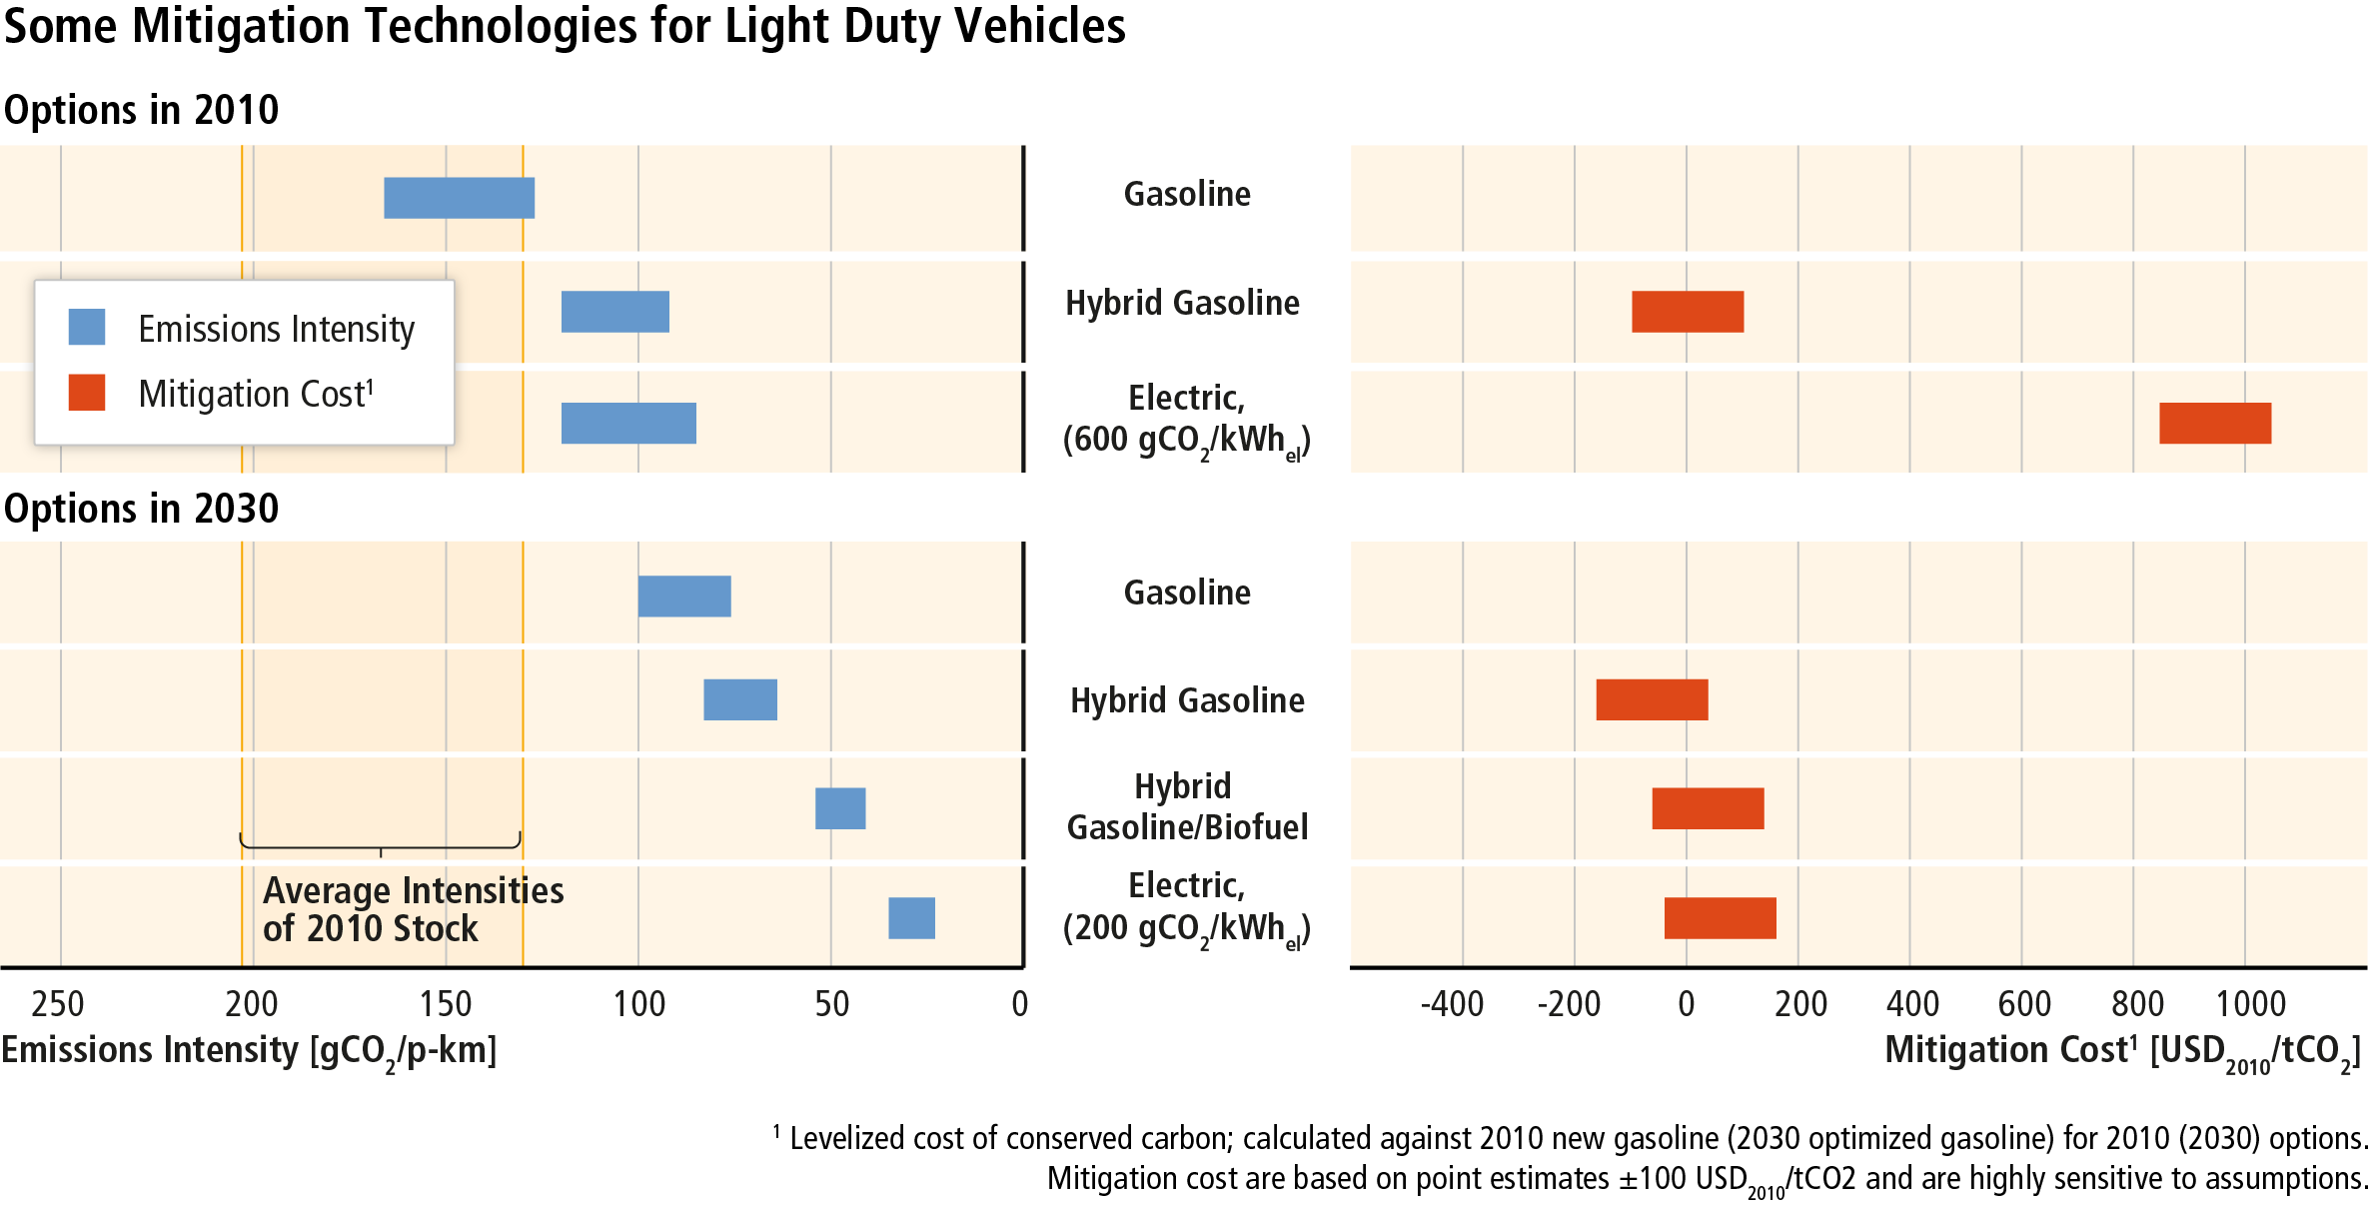
Private costs of reducing emissions in transport vary widely. Societal costs remain uncertain.
Based on Figure TS.21

Slide 42
Effective mitigation will not be achieved if individual agents advance their own interests independently.

Slide 43
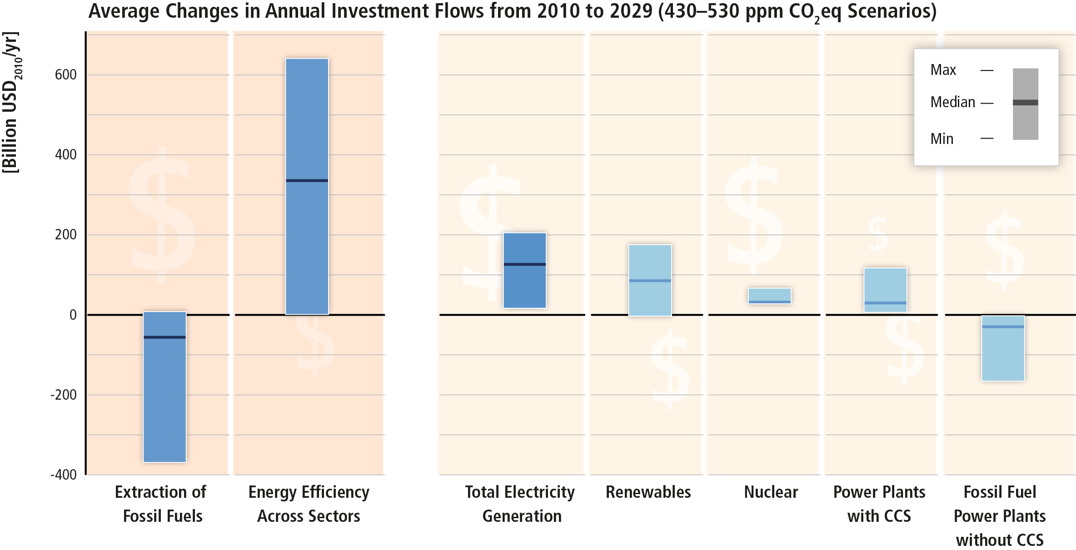
Substantial reductions in emissions require significant changes in investment patterns and appropriate policies.
Based on Figure SPM.9

Slide 44
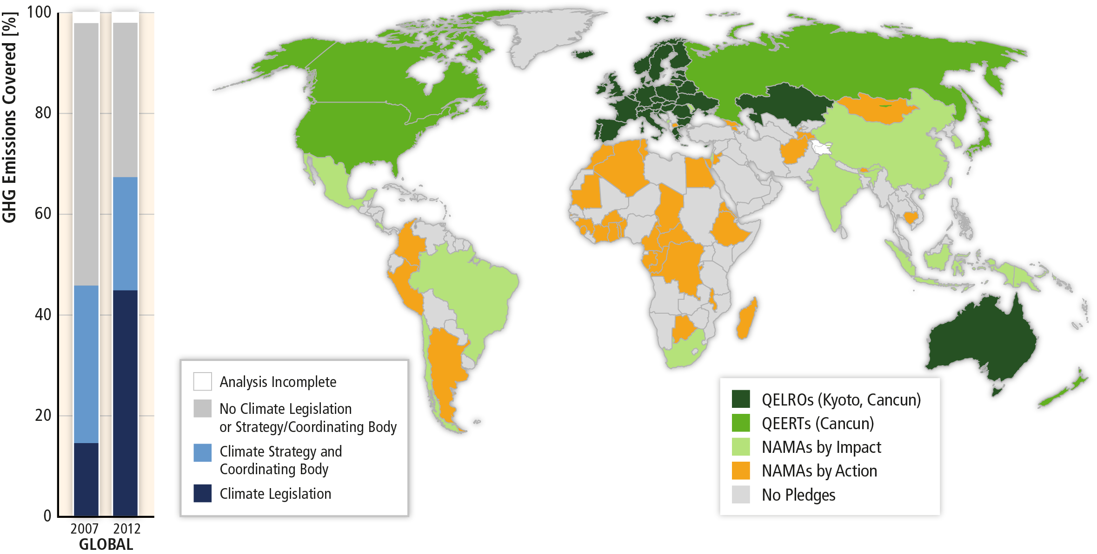
There has been a considerable increase in national and sub-national mitigation policies since AR4.
Based on Figures 15.1 and 13.3

Slide 45
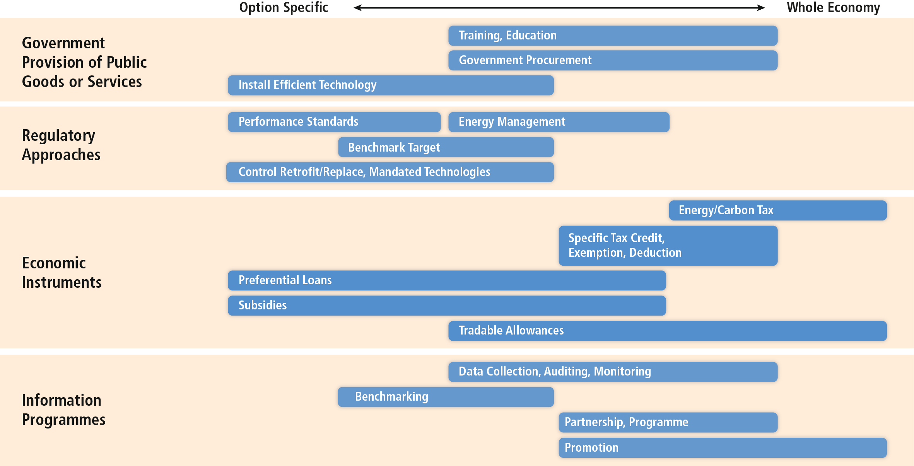
Sector-specific policies have been more widely used than economy-wide policies.
Based on Figure 10.15

Slide 46
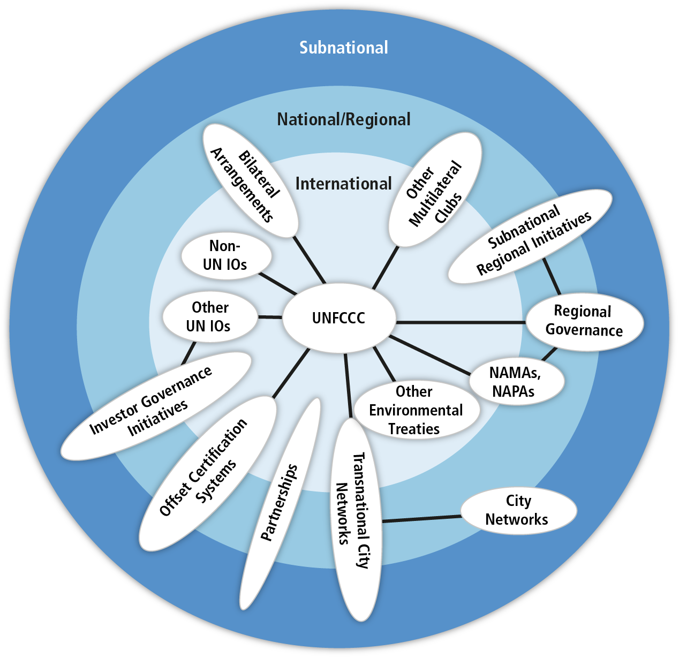
Climate change mitigation requires international cooperation across scales.
Based on Figure 13.1

Slide 47
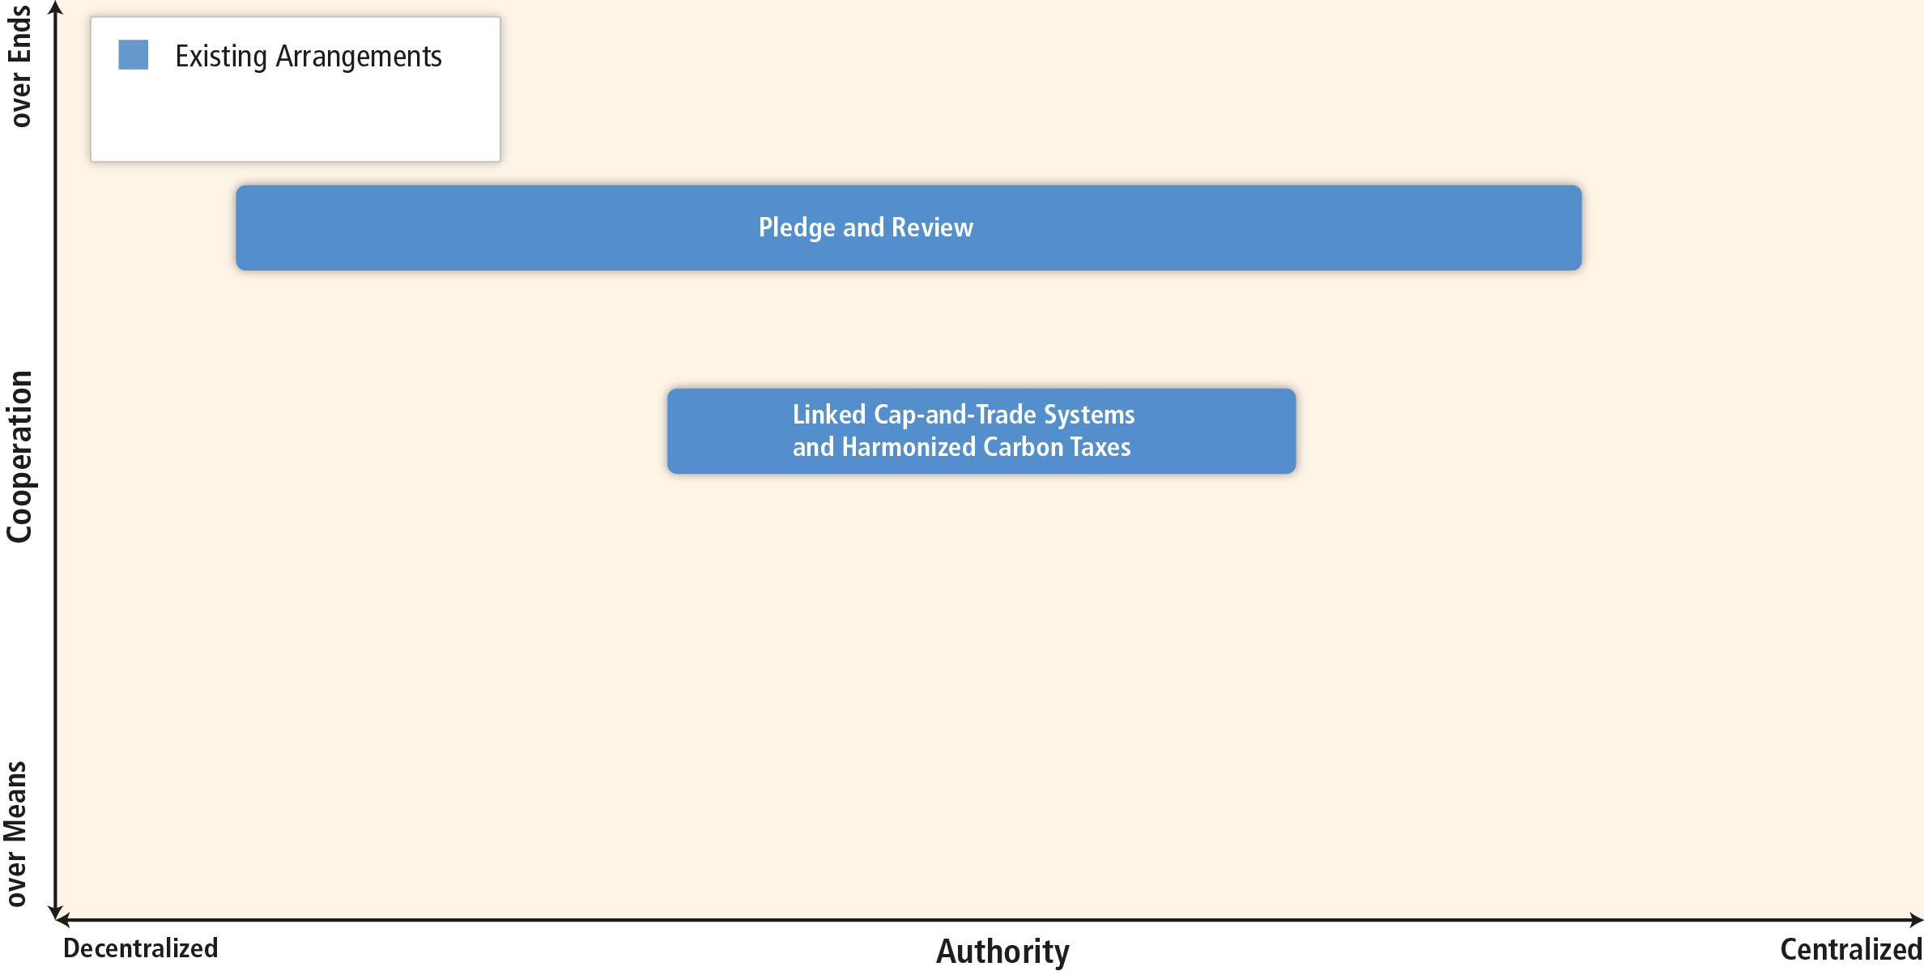
International cooperation can focus on the ends or means and vary in the degree of centralization.
Based on Figure 13.2

Slide 48
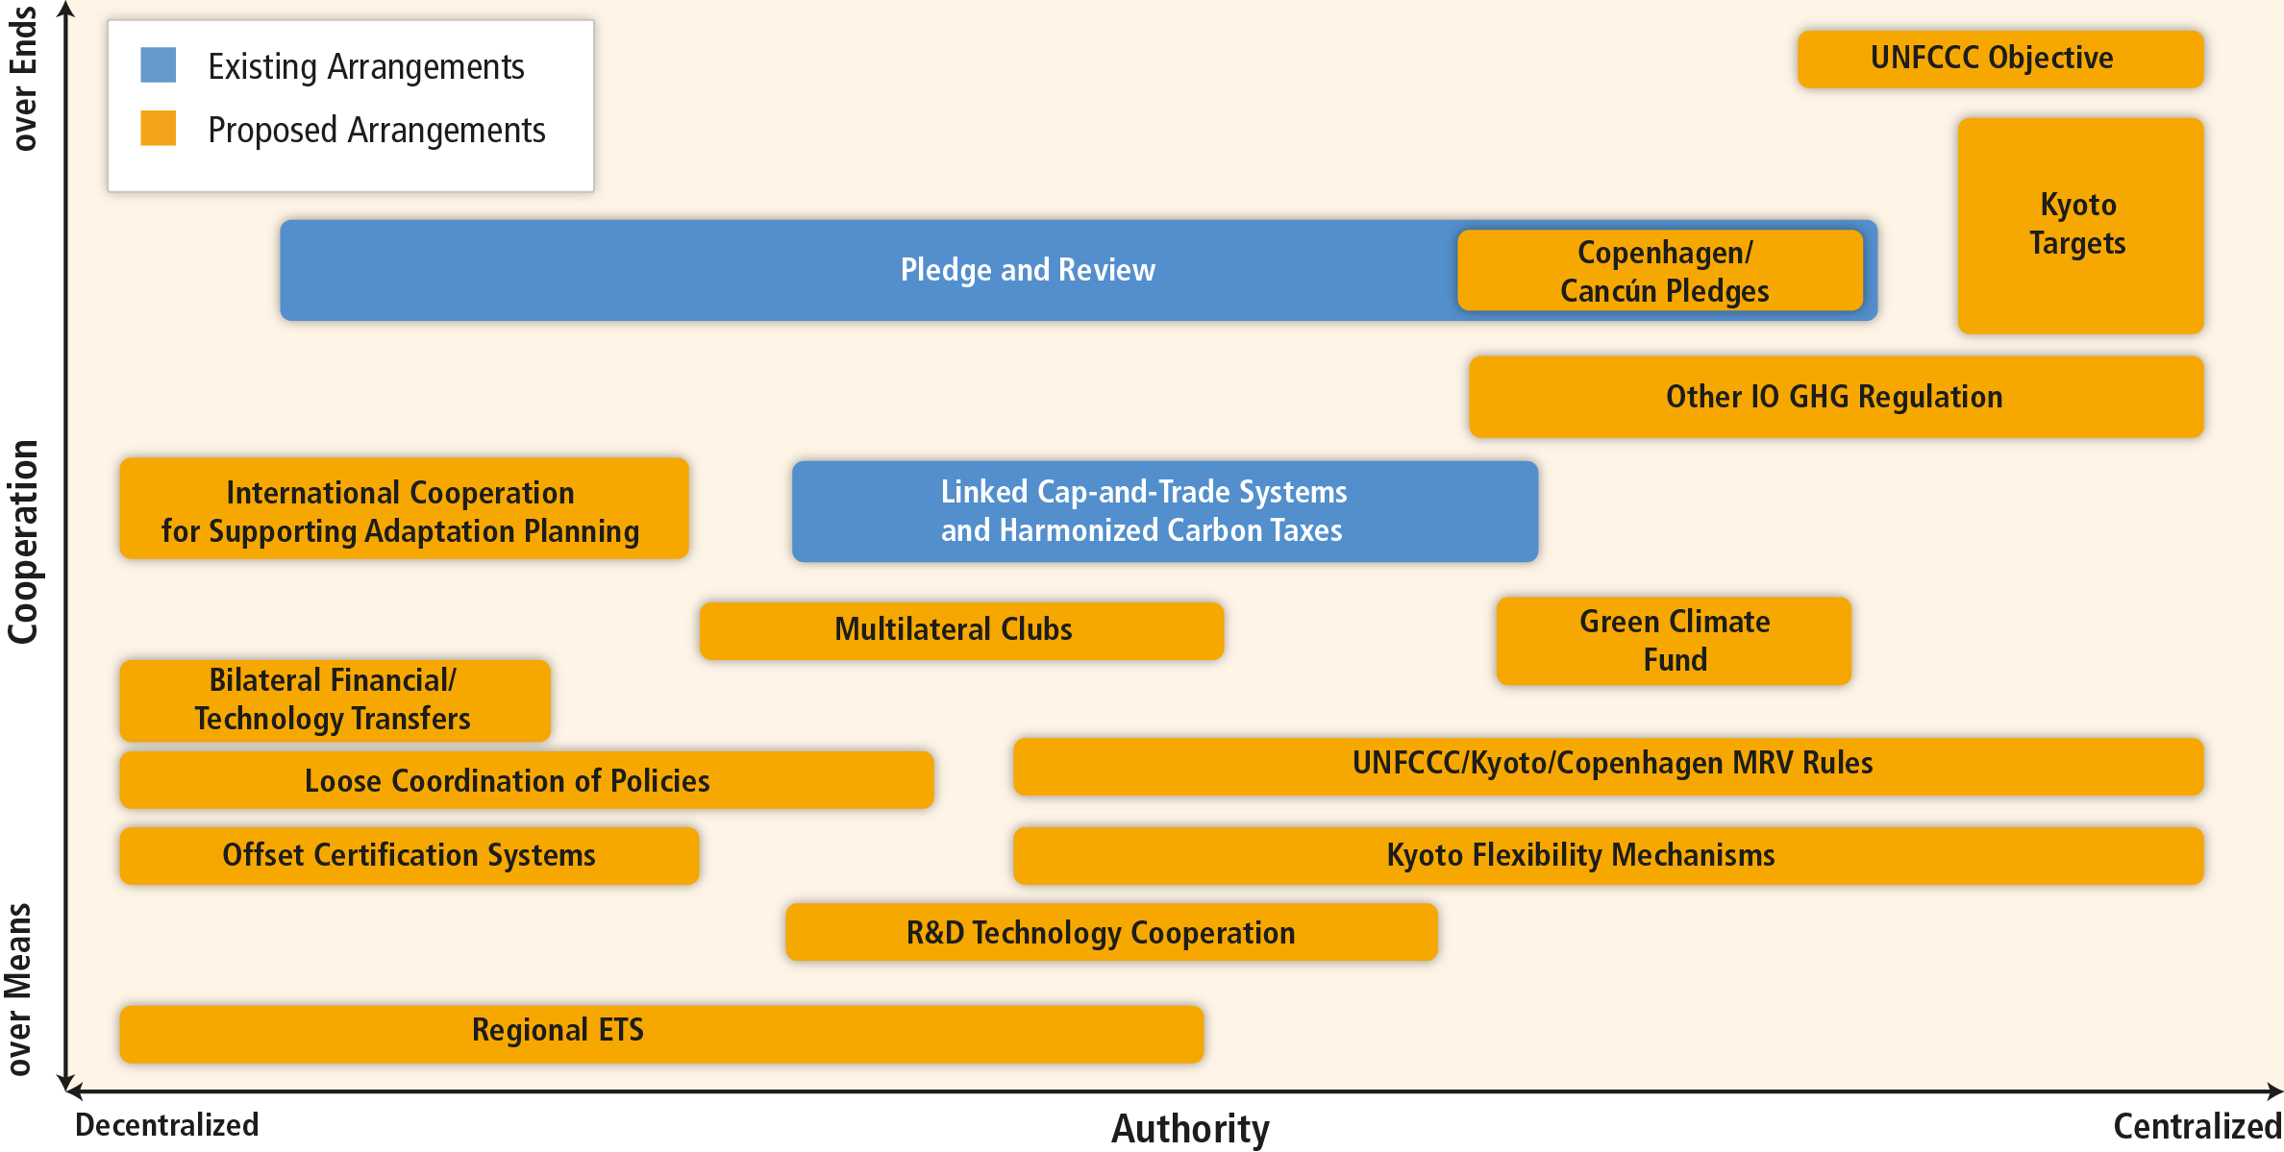
Effective mitigation will not be achieved if individual agents advance their own interests independently.
Based on Figure 13.2

Slide 49
www.mitigation2014.org
Notes:
More more details, please visit mitigation2014.org

